Slide 1
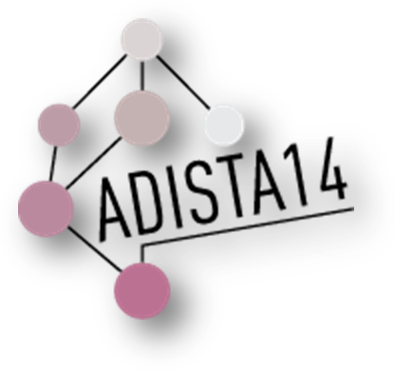

Angular regression
Louis-Paul Rivest
S. Baillargeon, T. Duchesne, D. Fortin & A. Nicosia

Slide 2
Summary
1- Animal movement in ecology
2- A general regression model for circular variable
3- Modeling the errors
4- Data analysis and simulation results

Slide 3
Animal movement in ecology
Study the interaction between an animal and its environment using
GIS data on land cover
GPS data on animal motion
Special software (ArGIS) is used to merge the data together

Slide 4
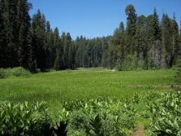
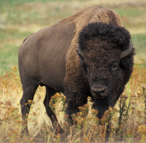


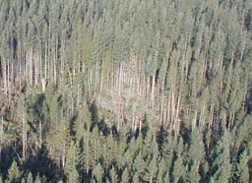
Animal movement in ecology
Target 1: meadow
Dependent variable: y_{t} motion angle at time t.
Predicted value: μ(y| x_{1t ,} …) a compromise between several targets
x_{1t}
P_{t+1}
Target 2: Canopy gap
y_{t}
x_{2t}
P_{t}
P_{t-1}
y_{t-1}

Slide 5


Animal movement
Ecologists are uneasy about combining targets’ directions.
McClintock et al. (Ecological Monograph 2012) define a compromise λ_{z,t} between the angles φ_{t-1} and μ_{z,t} as
Not right for a
non integer η_{z}
They are not fully satisfied with their definition. They add a word of caution:
without providing details.

Slide 6
A general circular regression model
Let (x₁, z₁),..., (x_{p}, z_{p}) be explanatory variables measured on each unit where x is an angle and z is a positive linear variable.
The mean direction of y given (x₁, z₁),..., (x_{p}, z_{p}), μ(y|x, z), is the direction of

Slide 7
Motivating example: latent classes
Mixture model: Each target is associated to a state. Given state j the conditional model for y_{i} is x_{ji} plus some errors
The unconditional mean direction of y_{i} is μ(y|x,z) with z=1 and β_{j}∼ρ_{j} p_{j}.
ρ_{j} =E{cos(ε _{j} )} is the mean resultant length of the deviations ε_{j} in state j

Slide 8
A general circular regression model
Standardization: β₁ = z₁ =1.
Examples (z=1):
Mean direction model x₁=0, and x₂=π/2
Rotation model x₁=w, and x₂=w+π/2

Slide 9
A general circular regression model
Examples (z=1):
Decentred predictor (Rivest, 1997) x₁=w, and x₂=w+π/2, x₃=0, and x₃=π/2

Slide 10
A general circular regression model
Presnell & all (1998) model: z₁ = z₂ =0, z₃ = z₄ =w, x₁=0, x₂=π/2, x₃=0, x₄=π/2,
Jammalamadaka & Sen Gupta (2001) models. The Moebius model of Downs & Mardia (2002) does not belong!

Slide 11
Models for the errors
We use the von Mises density for both specifications:
with population MRL .
This is a modified
Bessel function

Slide 12
Modeling the errors
von Mises variable
Option 1 (homogeneity model):
The density of ε does not depend on neither x nor z. It is von Mises with concentration parameter κ.

Slide 13
Modeling the errors
von Mises variable
Option 2 (Consensus, Presnell et al, 1998):
The concentration parameter of ε is κ ℓ, where ℓ is the length of
It is large when all the angles x_{j} point in the same direction.

Slide 14
Modeling the errors
The consensus model uses the parameters β to model the mean direction and the concentration of the dependent angle y.
Wouldn’t it be better to use two independent sets of parameters, one for the direction and one for the error concentration, (Fisher, 1992 mixed models)?

Slide 15
Models for the errors
For the consensus model, the density of y given (x,z) is
This is the conditional distribution for a multivariate von Mises model (Mardia, 1975). This density belongs to the exponential family and parameter estimation should be easy.

Slide 16
Parameter estimation
Strategy:
Maximize the von Mises Likelihood (use several starting values for the homogeneous errors)
Use the inverse of the Fisher information matrix to approximate the sampling distributions of the estimates (model based)
Calculate robust sandwich variance covariance matrices for the parameter estimates (valid even if the model assumptions are violated)
Alternative estimation strategies: use the projected normal (Presnell & al., 1998) or the wrapped Cauchy as an error density.

Slide 17
Parameter estimation
Score functions [μ_{i}= μ(y|x_{i}, z_{i})] :
1-Homegenous errors
2-Consensur errors (κ_{j}=κβ_{j}, ℓ_{iκ} =κℓ_{i})

Slide 18
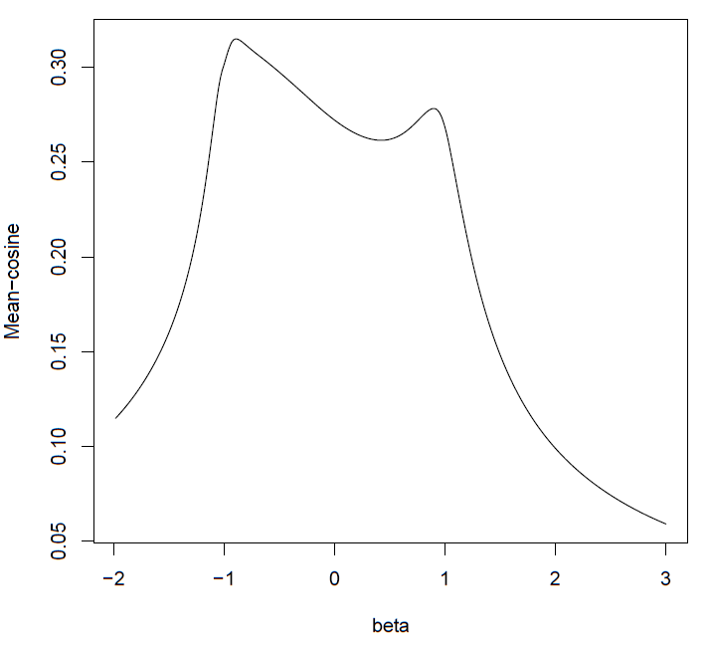
Parameter estimation
Data: (y_{i} , x_{i} , z_{i} ), i=1,...,n
Maximizing the von Mises likelihood with homogeneous errors leads to a max-cosine estimation criterion for the parameters {β_{j}}:
Numerical problems may occur.
Example: data simulated from the homogeneous error model:
n=50, p=2, β₂ =0.5
x₁ =0, x₂ ∼U(-π,π), κ=0.4

Slide 19
Parameter estimation
Properties:
The max-cosine estimator for β is consistent under the two error specifications, homogeneous and consensus;
When the errors are homogeneous, the consensus MLE might not be consistent. A lack of robustness to the specifications of the errors’ distribution is the price to pay for the numerical stability of the likelihood.

Slide 20
Parameter estimation
Properties:
Bias: In a one parameter model with homogenoeus errors, the consensus MLE underestimates β₂ (by up to 20%)
MLE: The algorithm that maximizes the homogeneous likelihood must use several starting values (more that 1000!)

Slide 21
A time series model
The conditional mean direction of y_{t} is a compromise between y_{t-1} and x₀ :
Under consensus errors with von Mises distributions
(Mardia et al, 2007)
Stationary distribution unknown for homogeneous errors.

Slide 22
A time series model
This is a “Biased Correlated Random Walk” in Ecology:
y_{t}= direction of animal movement at time t
x₀=x_{0t}= direction of a target to which an animal might be attracted (“Directional Bias”)
The estimation of β₂ relies on the methods presented earlier.

Slide 23
Example 1: Periwinkle data
y = direction of displacement
x = distance traveled
Presnell et al. (1998): projected normal errors
Presnell et al fit Consensus fit
Homogeneous fit: Numerical problems

Slide 24
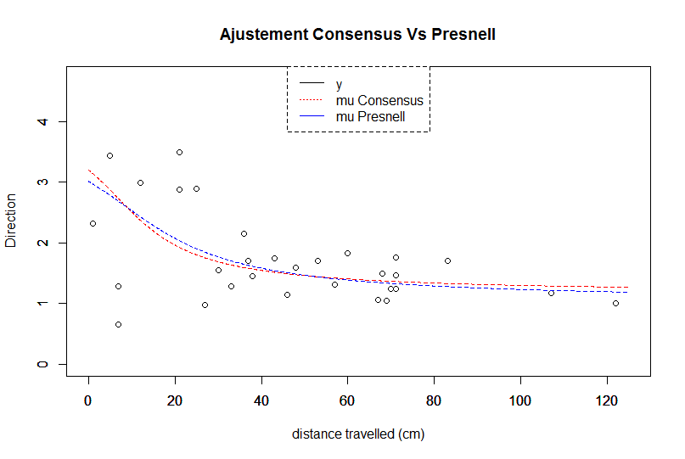
Example 1: Periwinkle data

Slide 25
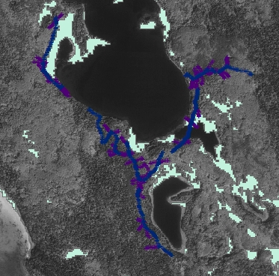
Example 2: Dancose (2011) digitized bison track data
y_{i} = track orientation for pixel i
x_{1i} = track orientation for pixel i-1
x_{2i} = angle for next meadow
z_{2i} = log(distance to next meadow)
x_{3i} = angle for next canopy gap
z_{3i} = log(distance to next canopy gap)
K=218 trails for 5600 pixels
Model considered

Slide 26
Bison track data: homegenous model
Model
estim. s.e.(R) s.e.(FI)
beta2 1.06 0.10 0.05 S
beta3 0.07 0.03 0.03 S
beta4 -0.16 0.018 0.009 S
beta5 -0.002 0.006 0.006 NS
The tracks are “biased” towards target meadows (TM) and canopy gaps.
When approaching a meadow, the bisons zoom in.
The weight of the TM angle is ∼1-0.16 log(D)/1.06≈D^{-0.15}.

Slide 27
Bison track data: consensus model
Model
estim Homo estim Consen se(FI)
beta2 1.06 1.24 0.05
beta3 0.07 0.07 0.03
beta4 -0.16 -0.19 0.009
beta5 -0.002 -0.003 0.006
The two sets of estimates are similar and lead to the same conclusion.

Slide 28
Discussion
Multivariate angular regression applies beyond animal movement:
Meteo: ensemble prediction of wind direction
Experimental psychology: real and perceived orientation of features
Geophysics: direction of earthquake ground movement and direction of steepest descent
Thank you!

Slide 29
References
Dancose, K., D. Fortin, and X. L. Guo. 2011. Mechanisms of functional connectivity: the case of free-ranging bison in a forest landscape. Ecological Applications 21:1871-1885.
Downs, T. D. and Mardia, K. V. (2002) Circular regression. Biometrika,89,683-697
Fisher, N.I., Lee A.J. (1992). Regression models for angular responses. Biometrics, 48, 665-677
Fortin & al (2005) Wolves influence elk movements: behavior shapes a trophic cascade in Yellowstone National Park, Ecology, 86(5), 2005, pp. 1320–1330
Jammalamadaka, S. R. and SenGupta, A. (2001) Topics in Circular Statistics. World Scientific: Singapour
Mardia, K.V. and Jupp, P.E. (1999) Directional Statistics,John Wiley, New York
Presnell, B., Morrison, S.P., and Littell, R.C. (1998). Projected multivariate linear models for directional data. JASA. 93(443): 1068-1077
Rivest, L.-P. (1997). A decentred predictor for circular-circular regression. Biometrika, 84, 717-726.

