Slide 1
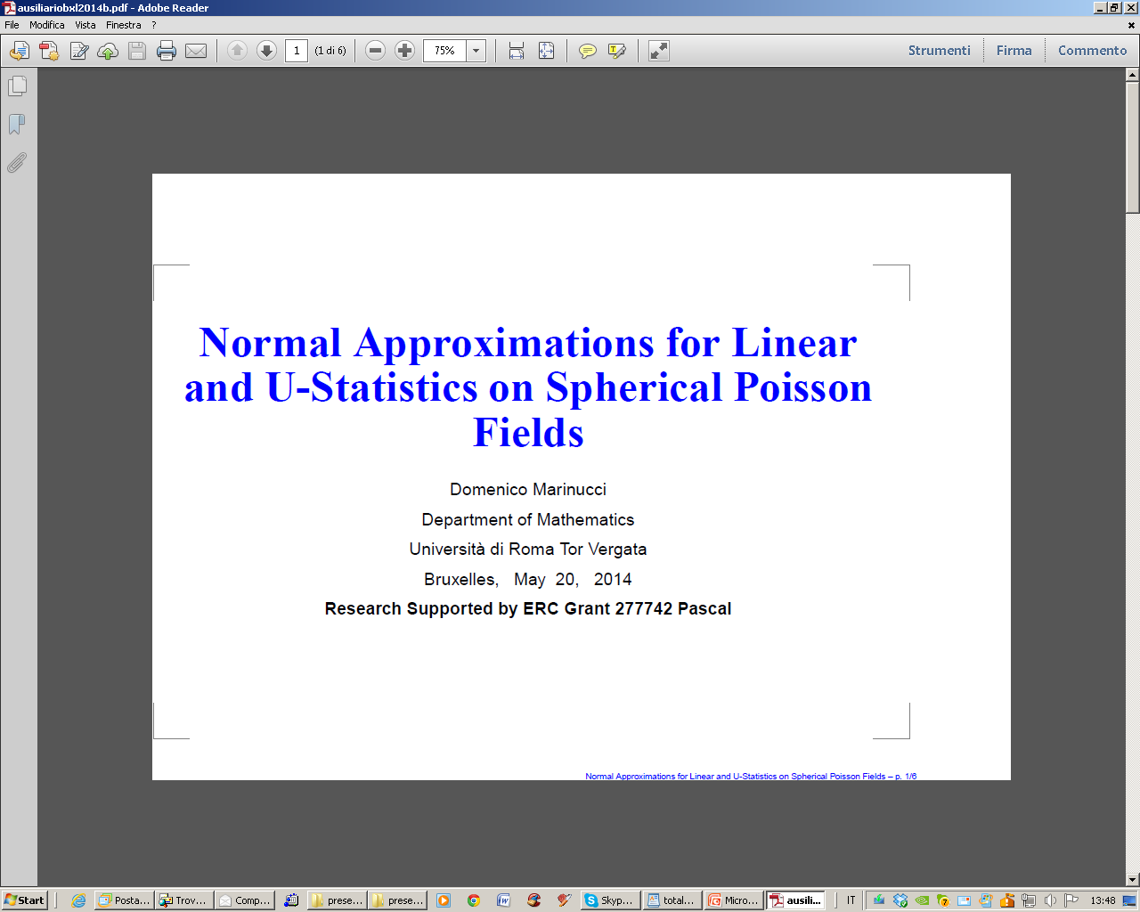
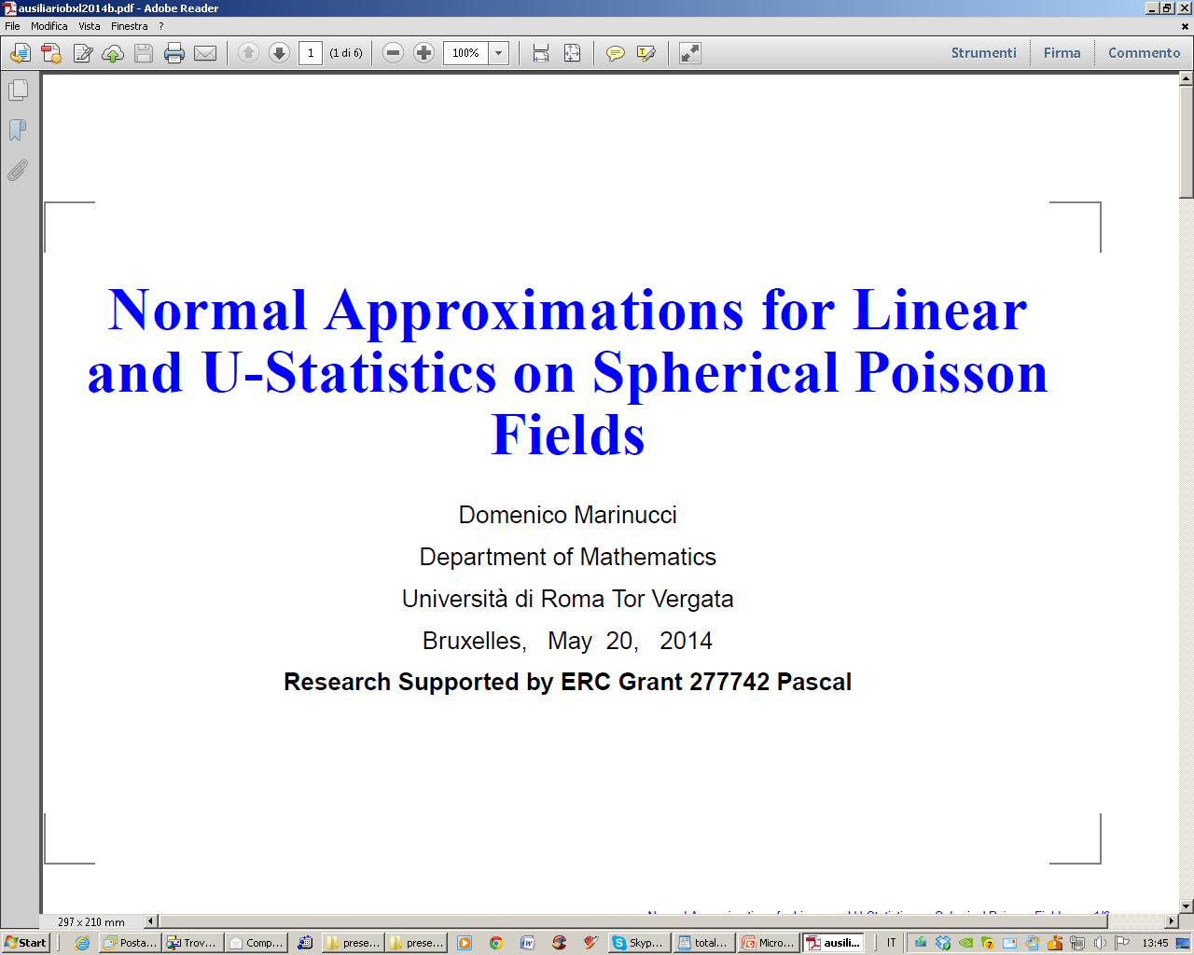
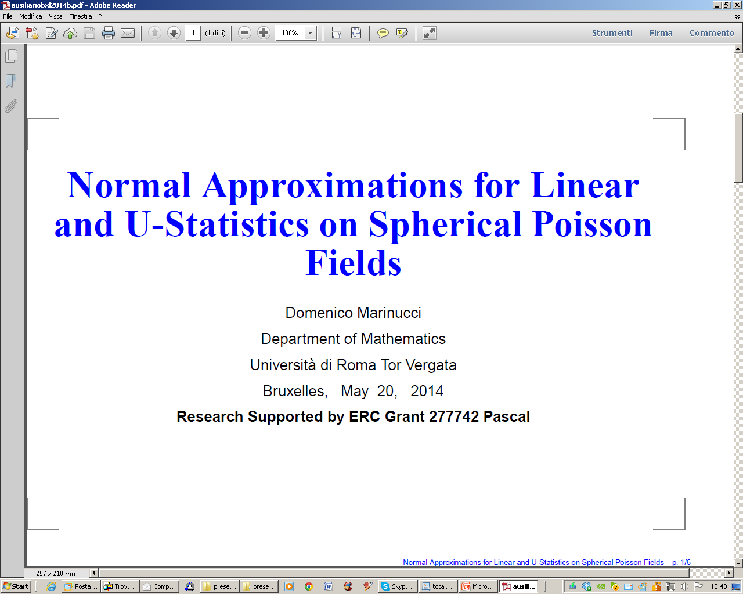

Slide 2
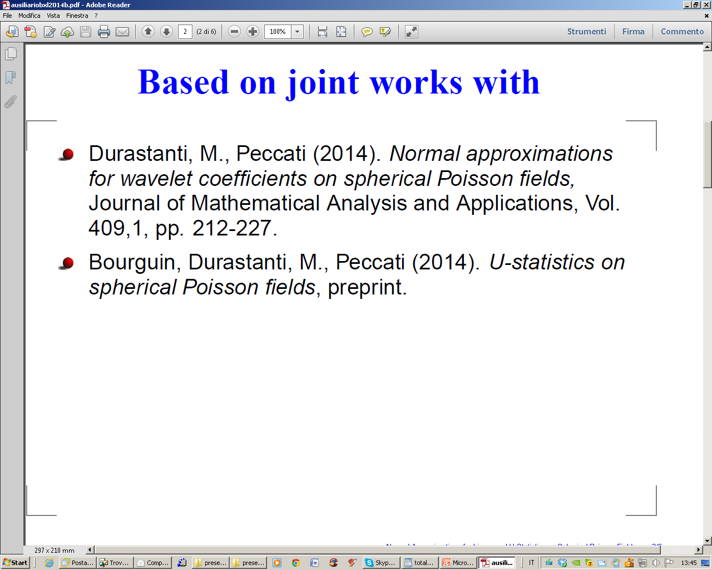
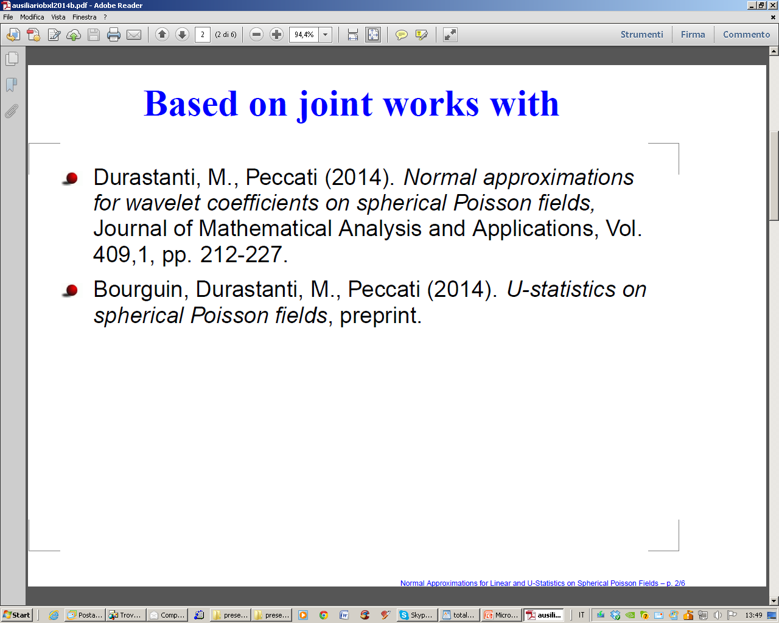

Slide 3
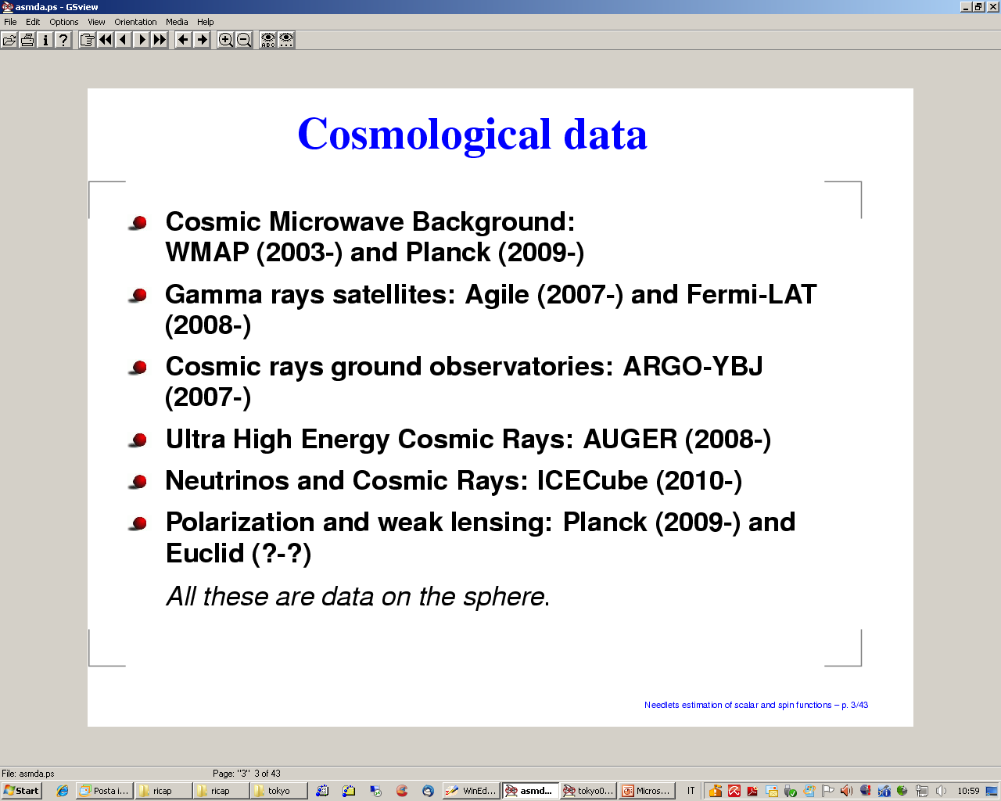
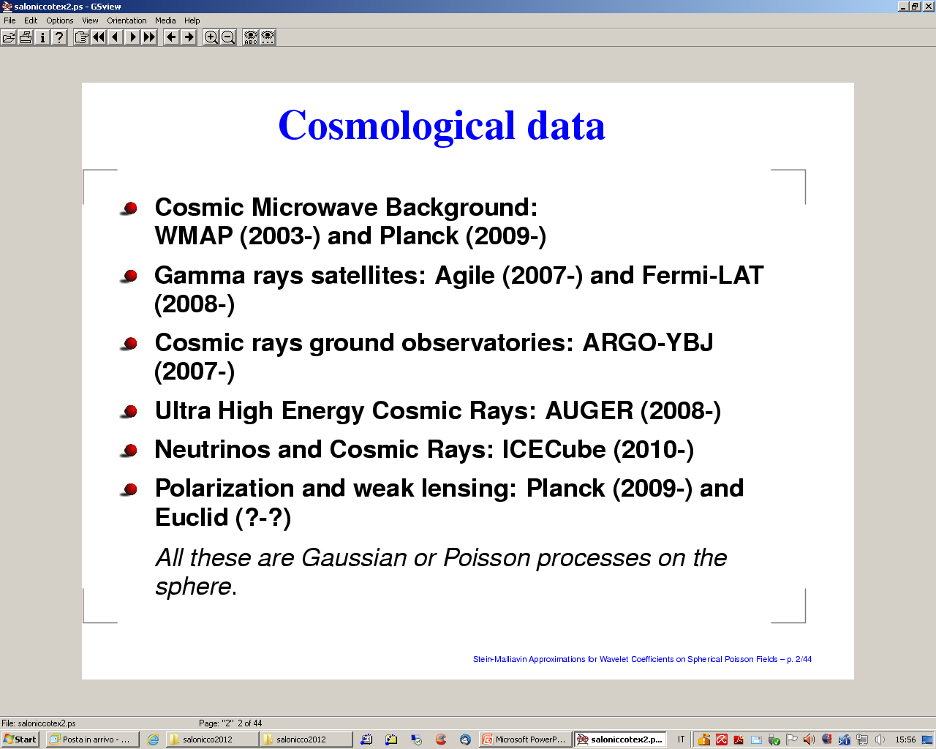

Slide 4
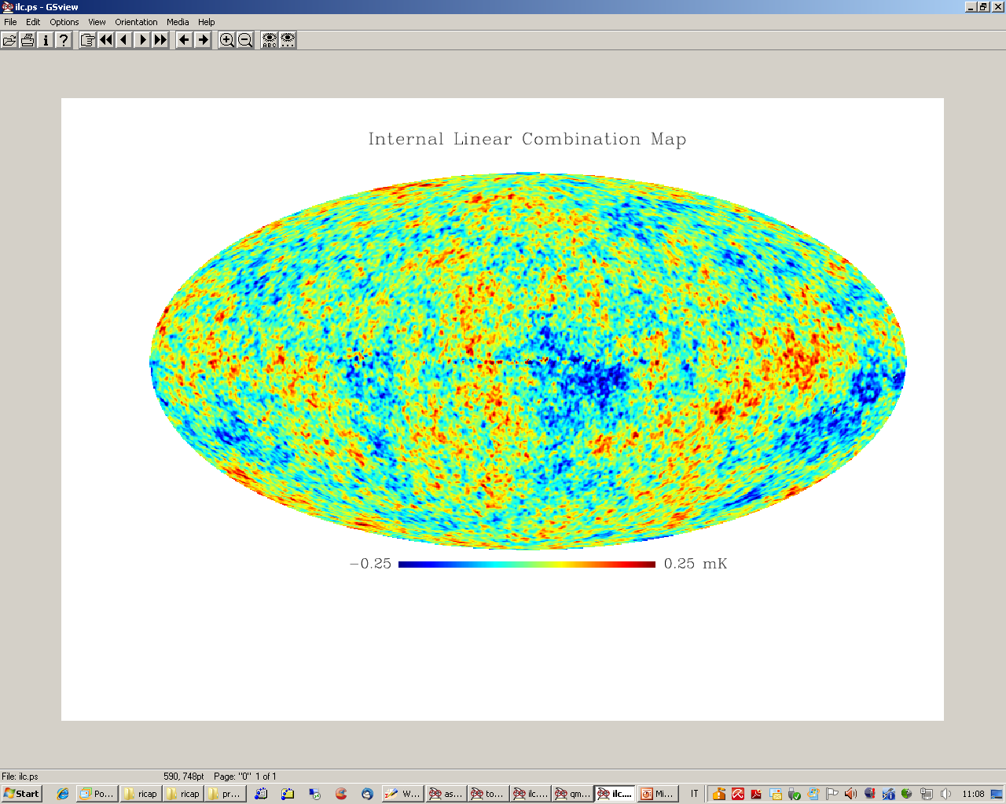

Slide 5
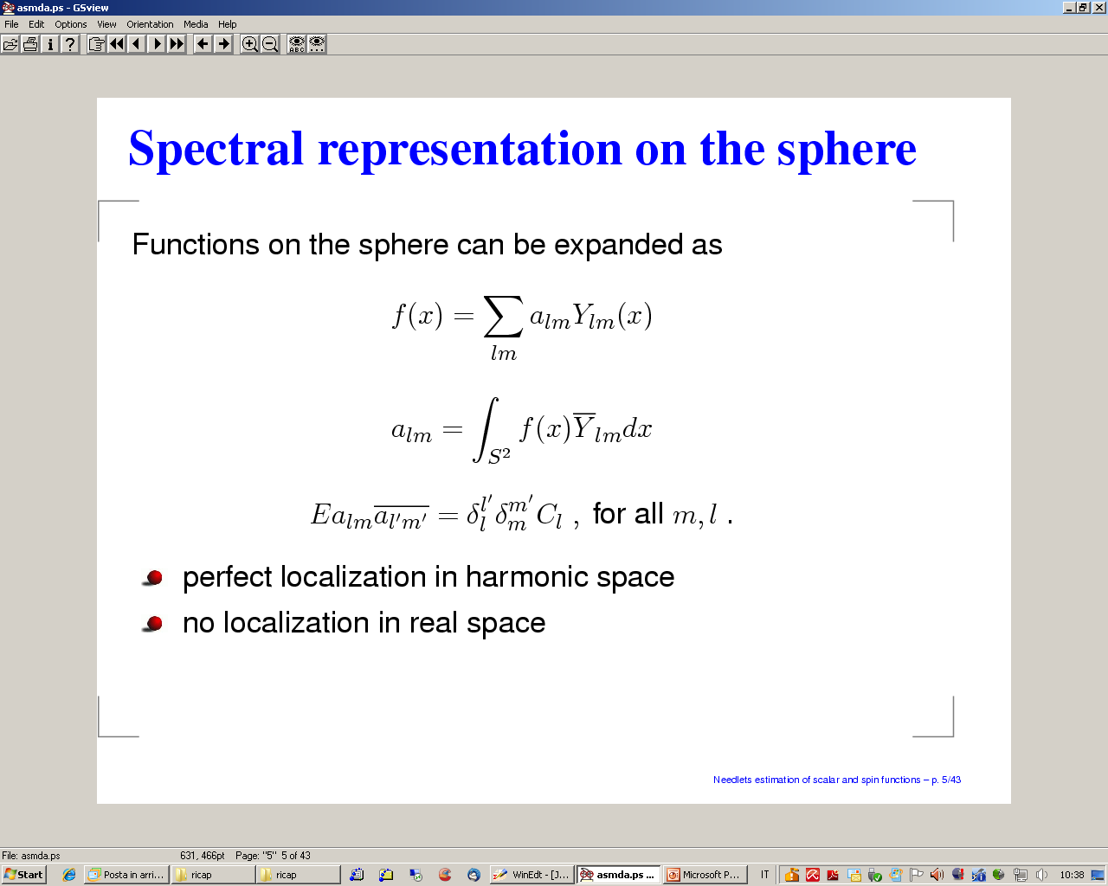

Slide 6
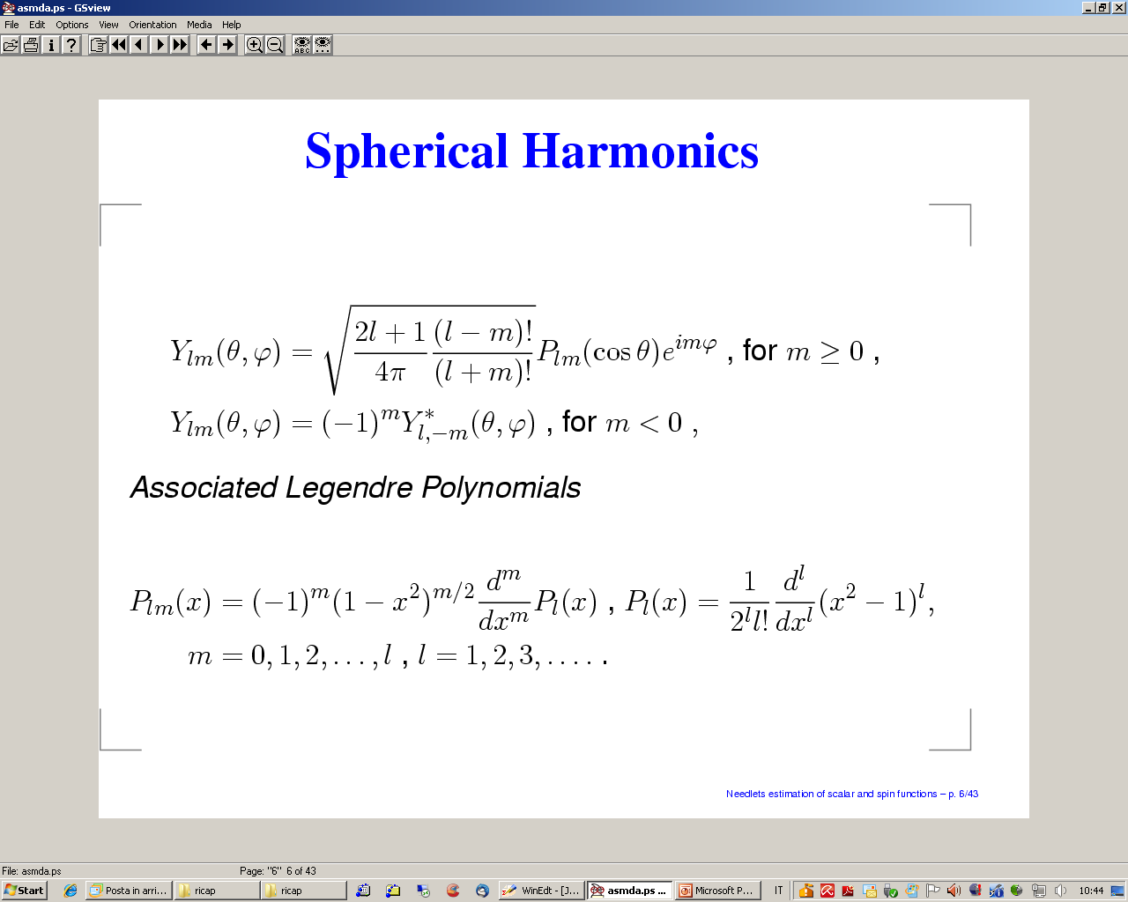

Slide 7
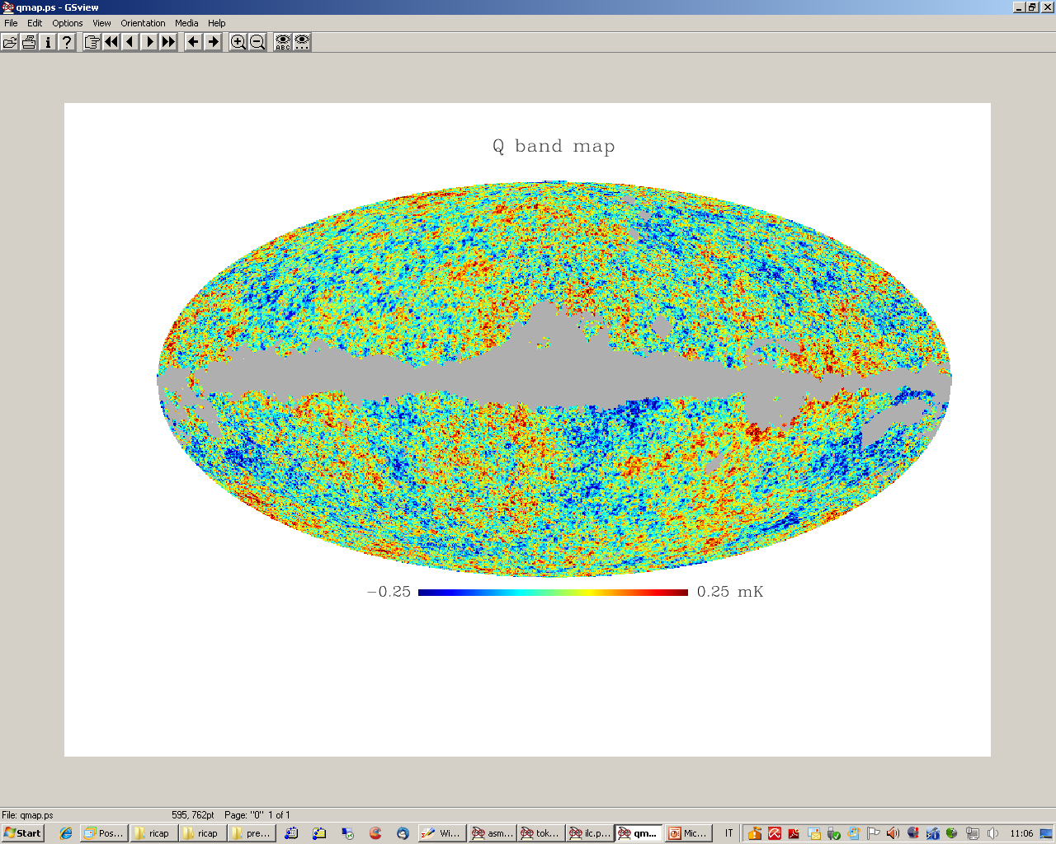

Slide 8
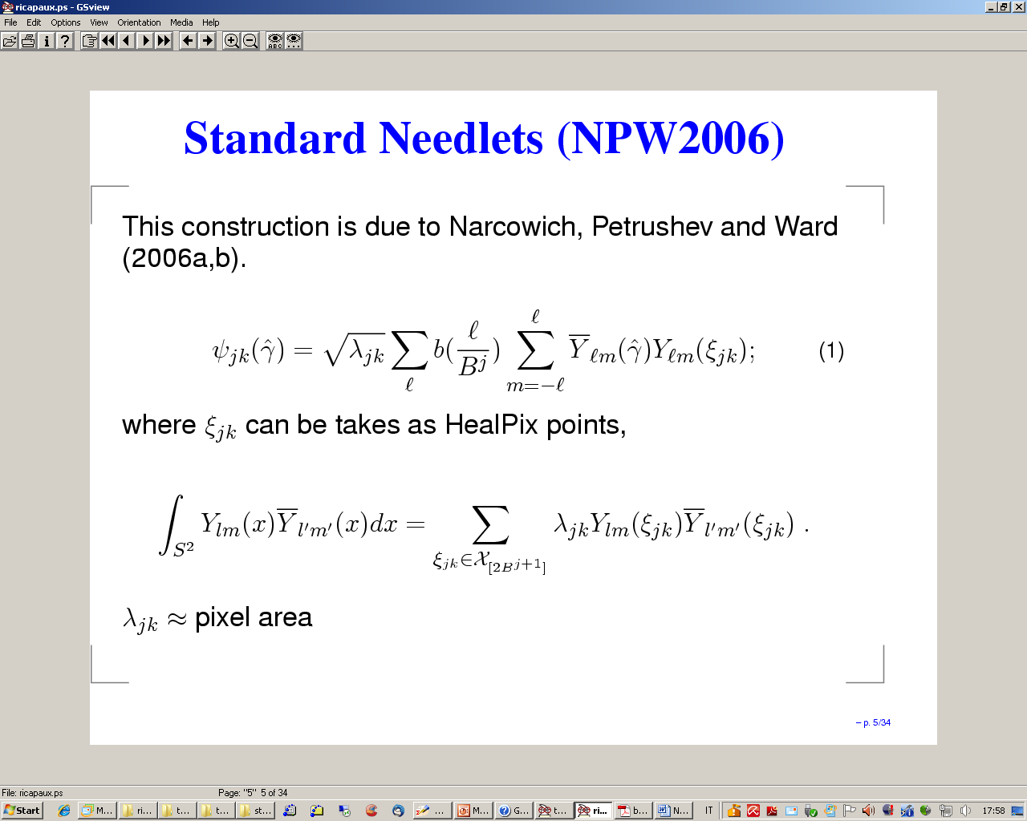

Slide 9
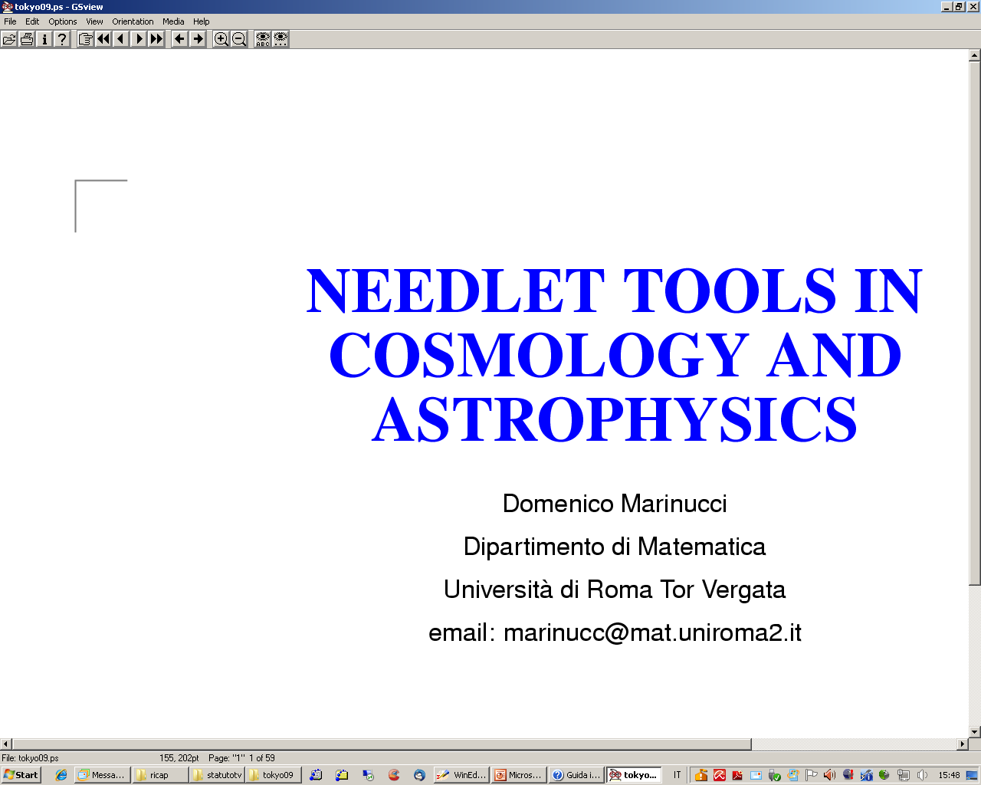
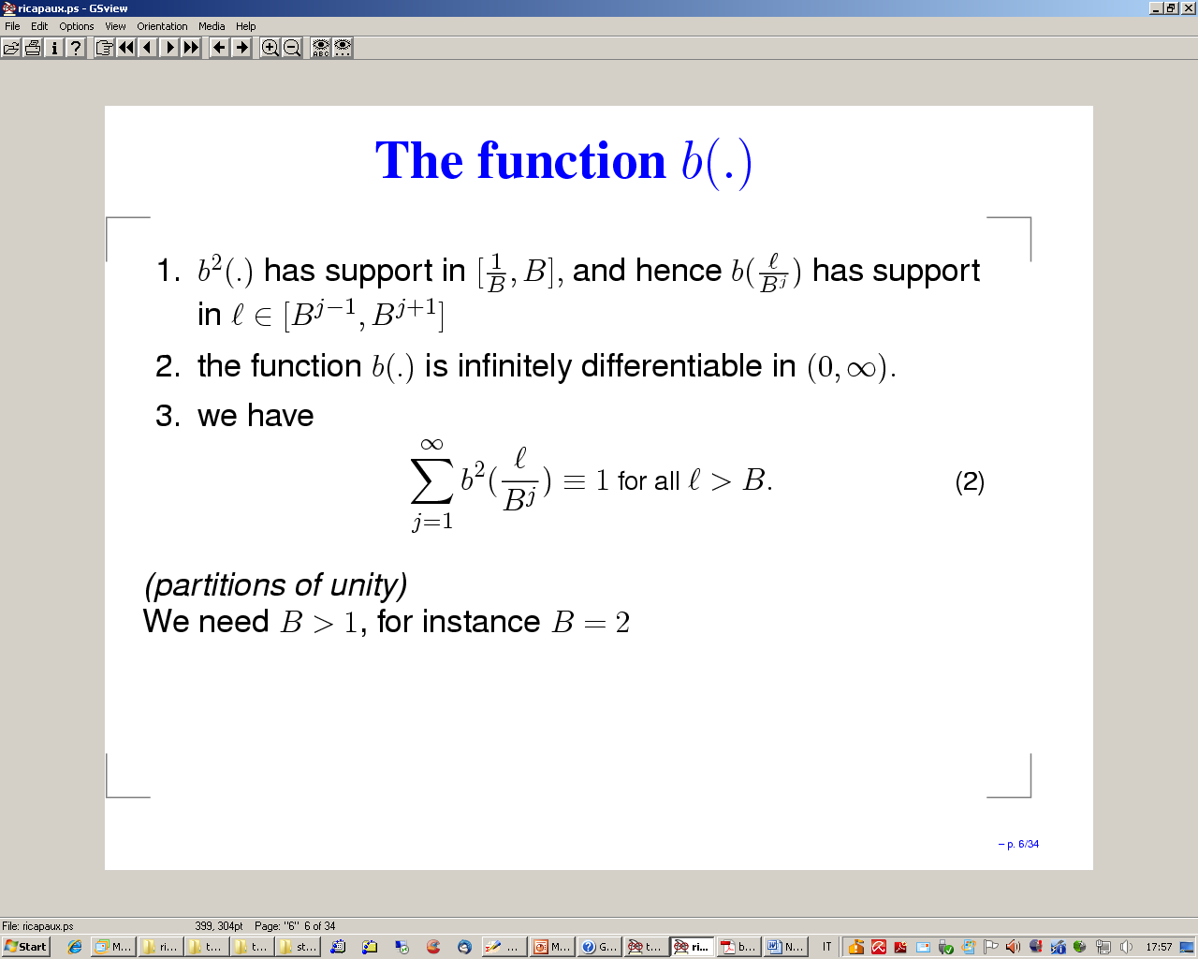
Needlets definition
NPW (2006)

Slide 10
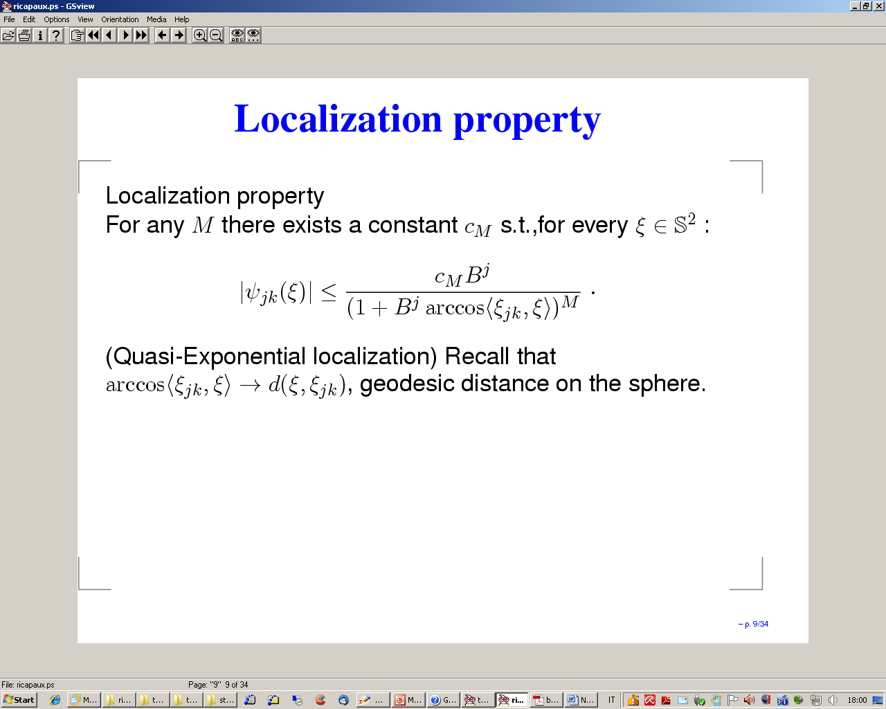

Slide 11
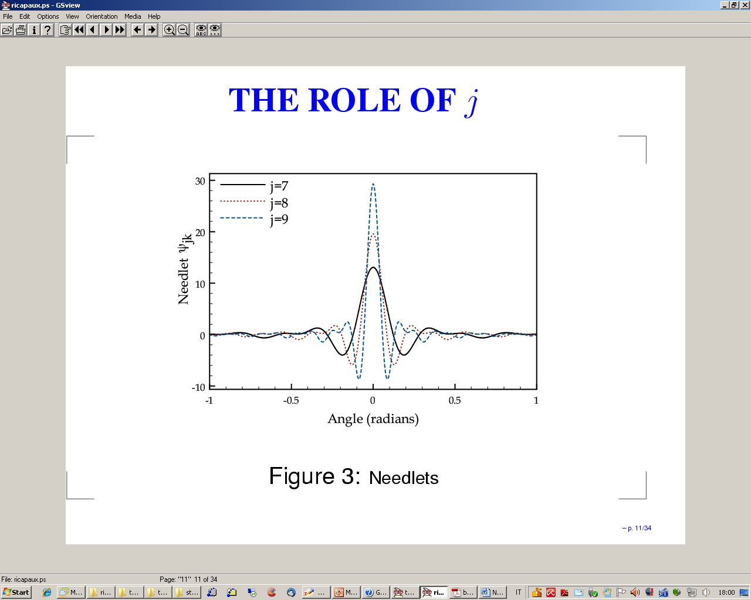

Slide 12
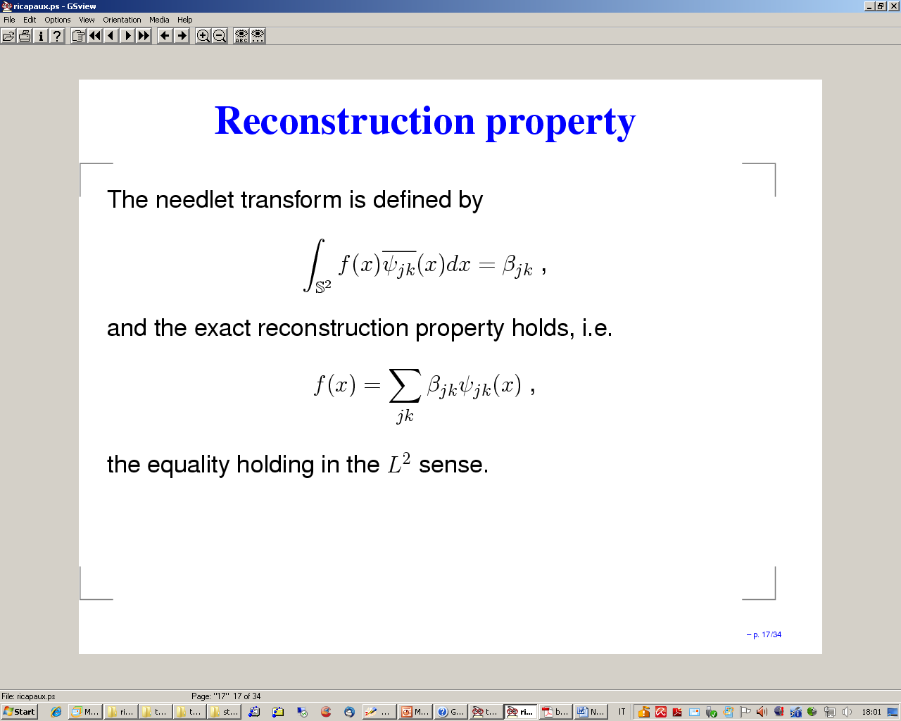

Slide 13
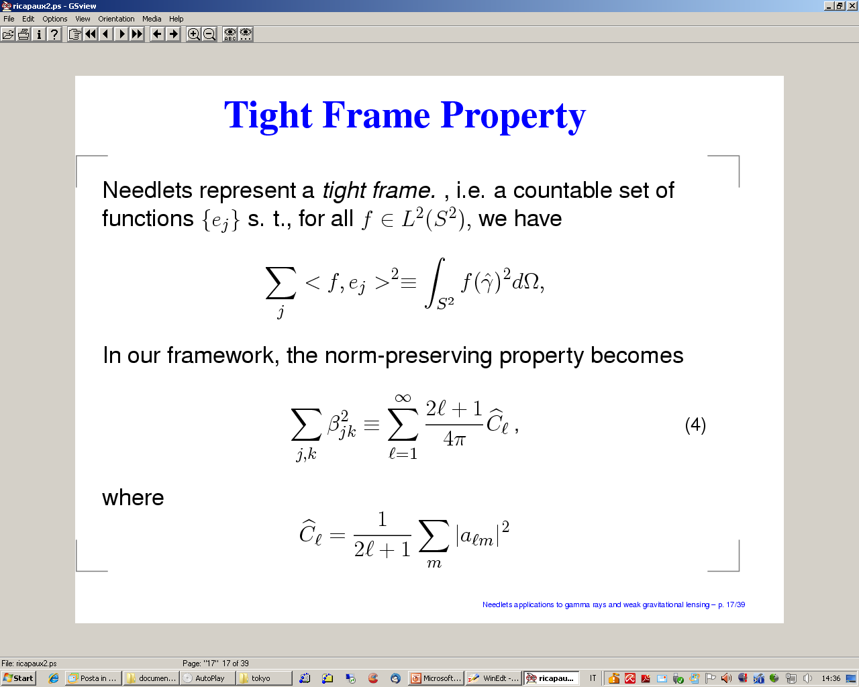

Slide 14
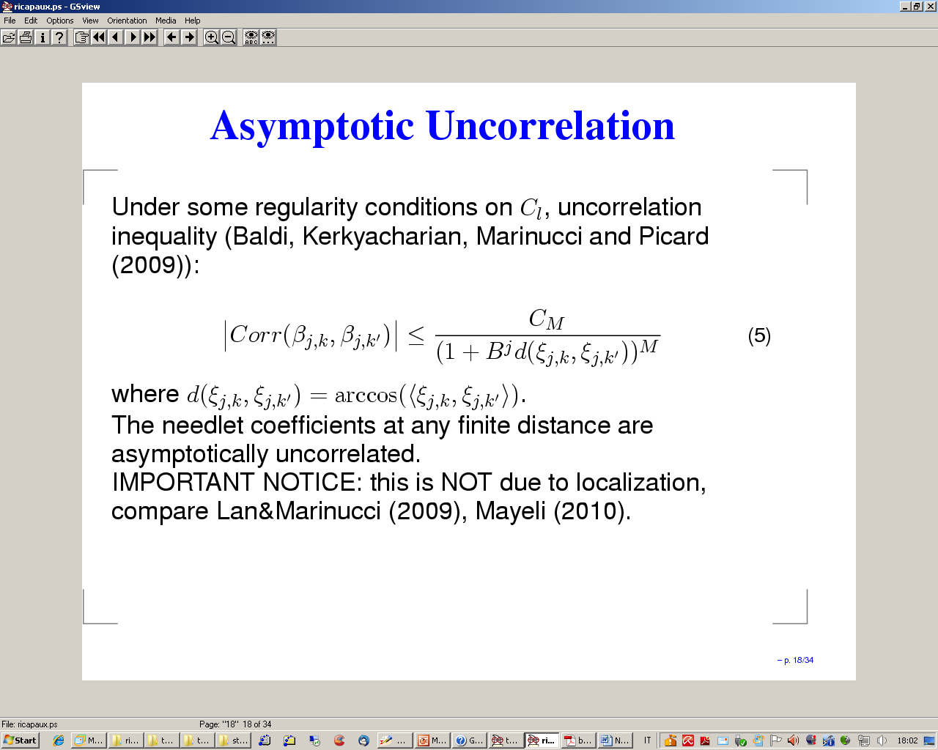
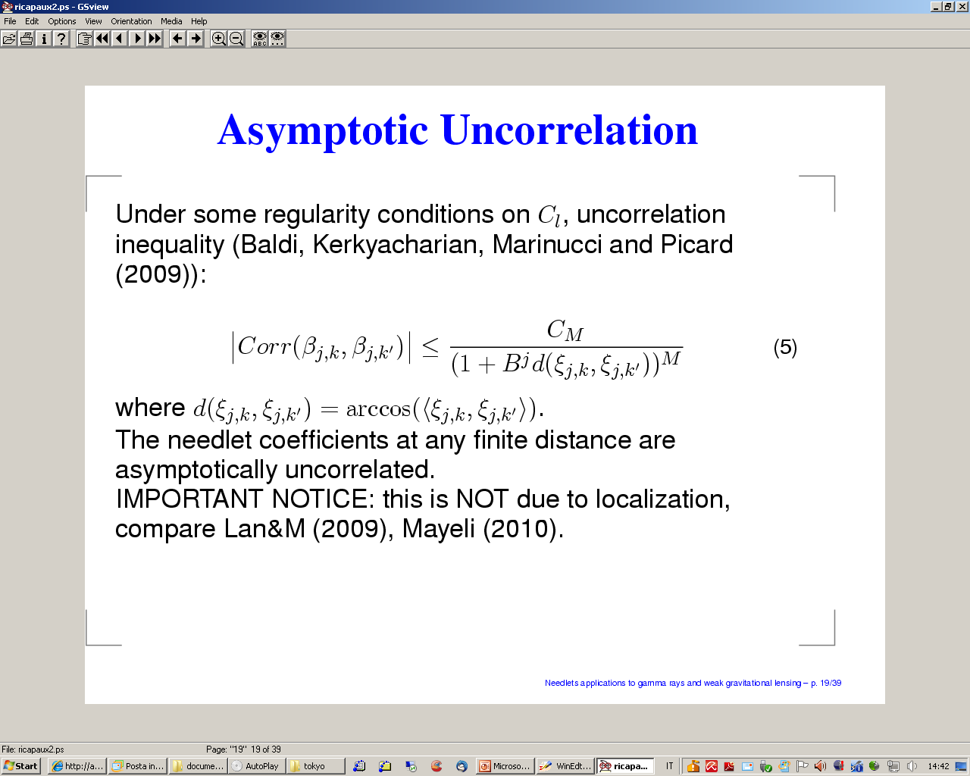

Slide 15
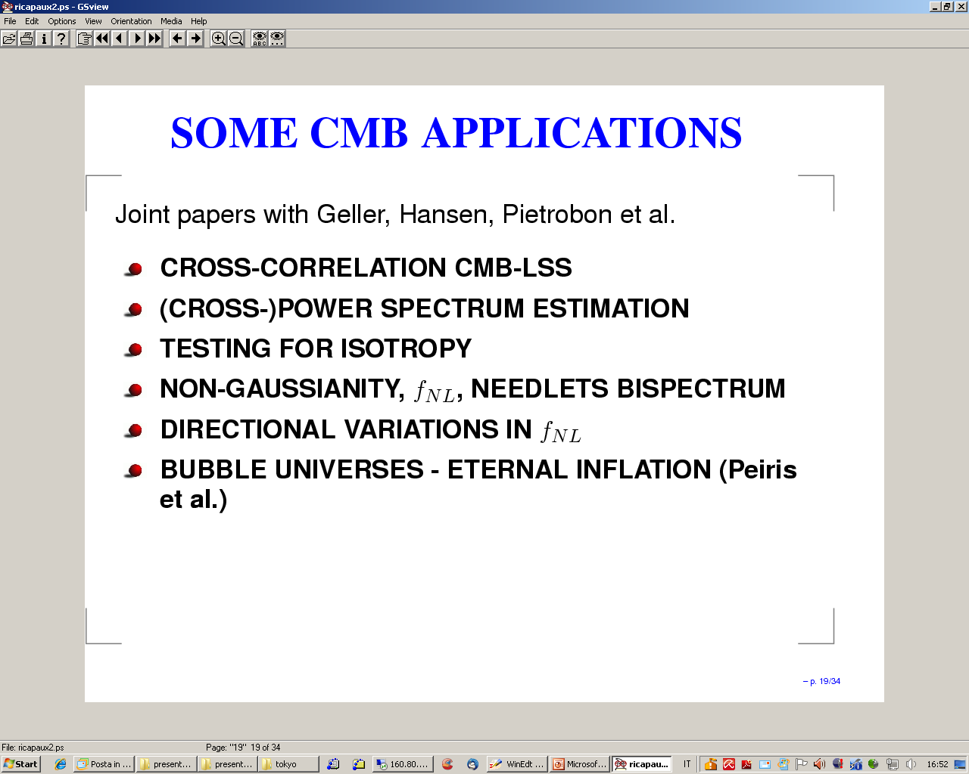
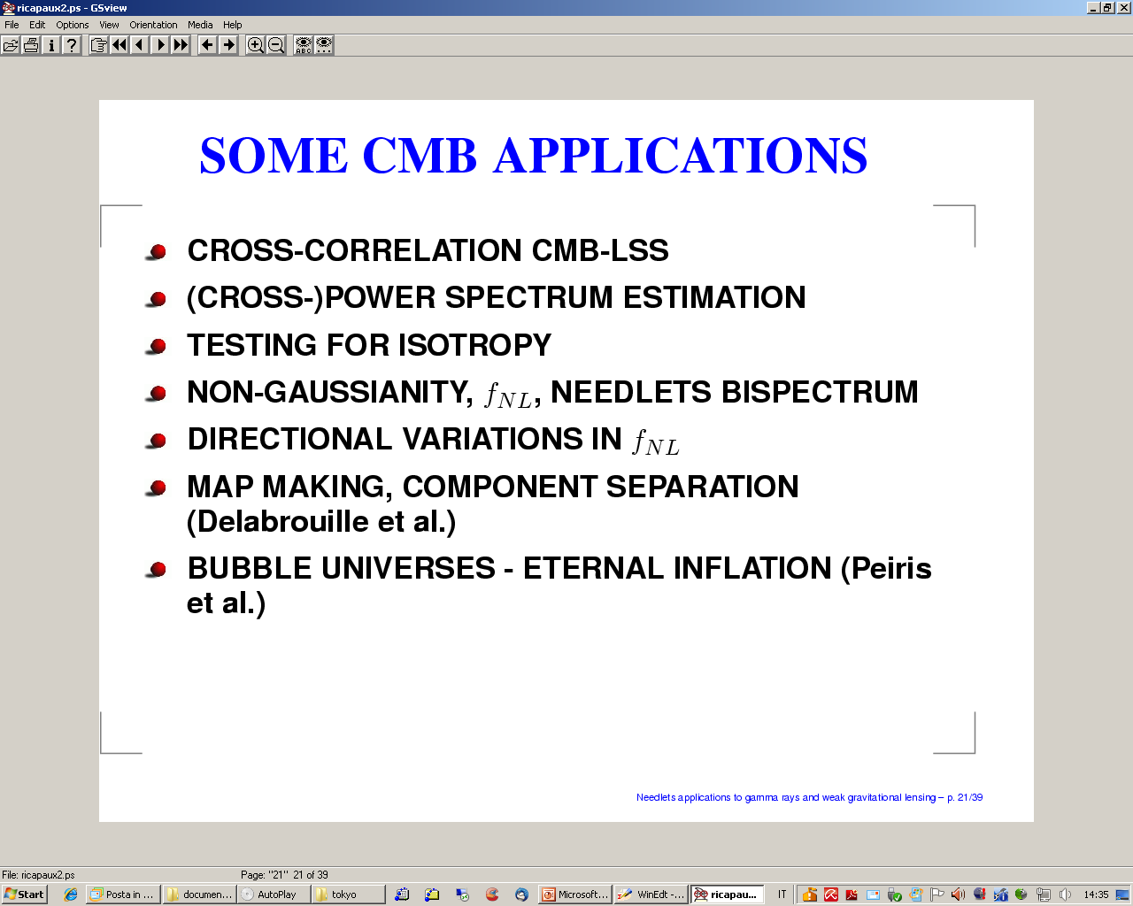

Slide 16
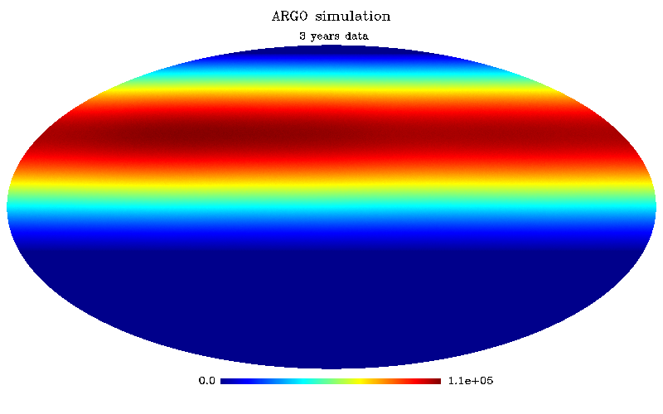

Results for ground-based telescopes with large field of view
celestial coordinates (r.a. and dec.)
SIMULATION DETAILS:
Sky map filled with
all the TeV sources in the field of view of ARGO
intermediate scale CRs anisotropies as observed by ARGO
isotropic CRs flux according to Horandel
The effect of the atmosphere, as well as that of the detector (efficiency, exposure and so on…) have been properly accounted for.
1.2X10¹¹ events to reproduce 3 years of data acquisition.
No selection cuts applied.
The signals lay on different angular scales, then we expect to observe them at different needlet orders.

Slide 17
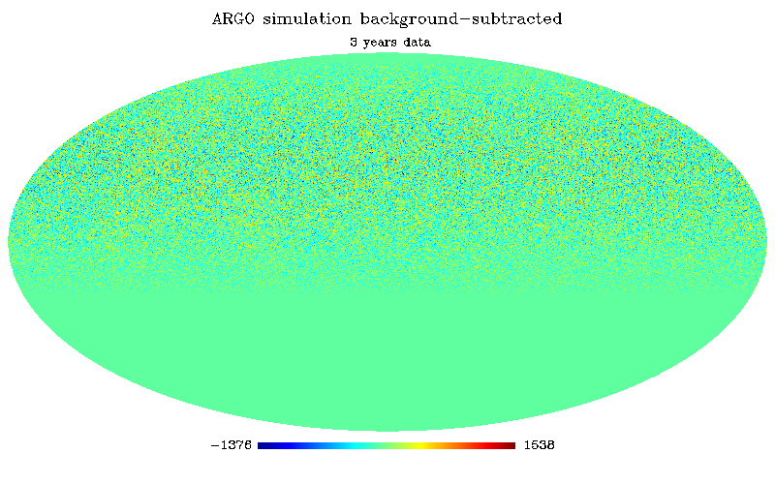
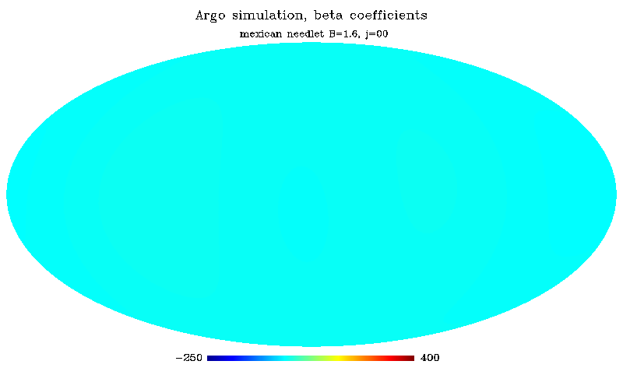
Needlet transform
Intermediate scale anisotropies visible at j=4-7
Point sources visible at j=8-10
The background-subtracted map is dominated by high frequency fluctuations.

Slide 18
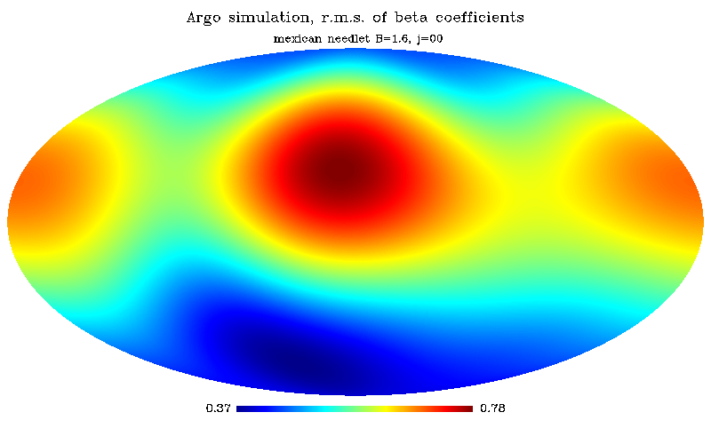
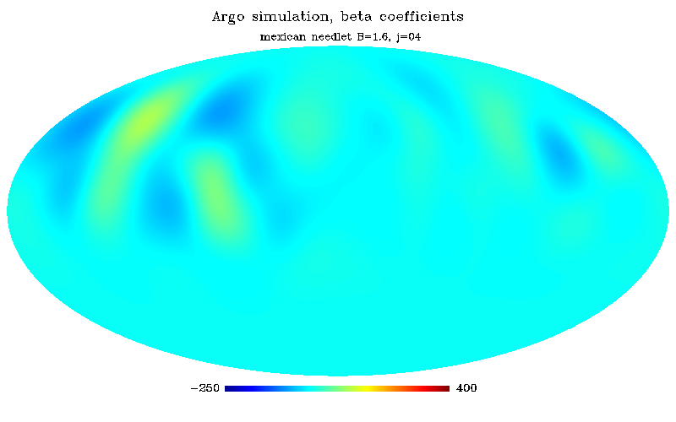
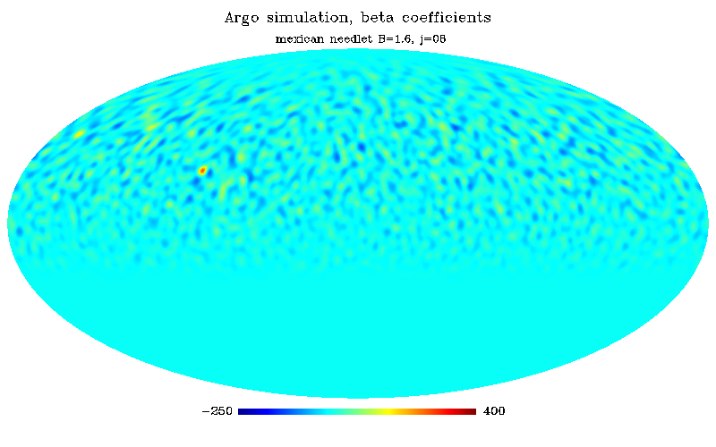
Estimation of the r.m.s.
The estimation of the r.m.s of each coefficient is easily obtained by MC simulation of the background.
1000 background samples
full needlet transform for each sample

Slide 19
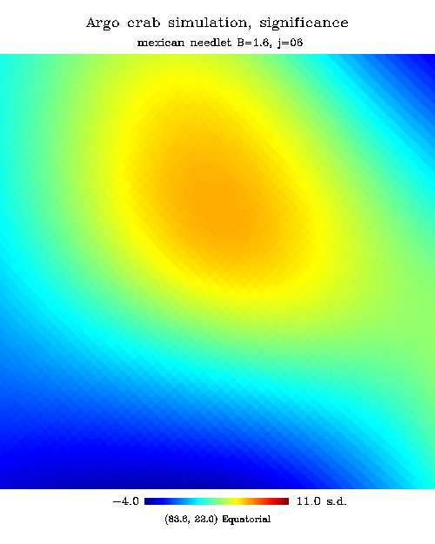
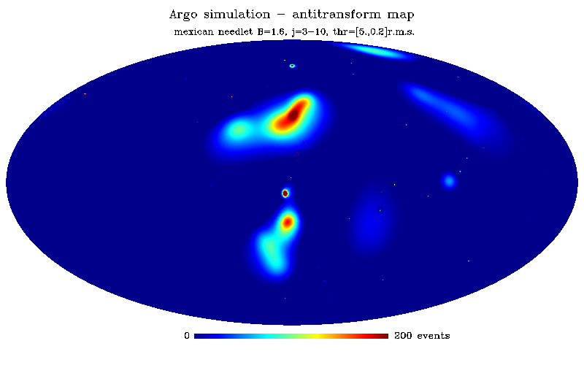
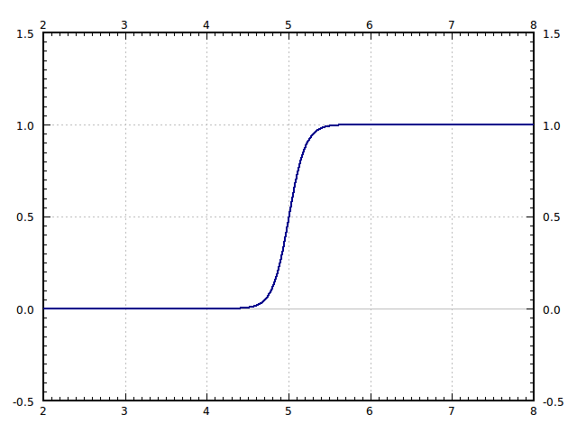
Managing the transform coefficients
You can use the estimation of the r.m.s. of the beta coefficients to get the significance of every point at every scale. Point source detection in the needlet space!
You can make the antitransform using only significant coefficients (e.g. “soft thresholding”).
Signals well separated even when overlap each other!
Weight function

Slide 20
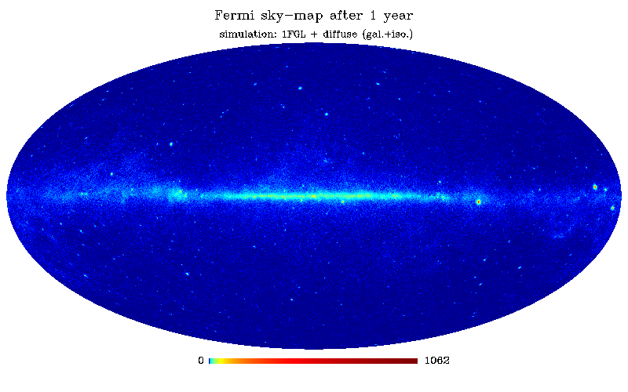
Simulation of the application to Fermi
Details of the simulation:
Point sources from the LAT 1-year Point Source Catalog (1451 sources)
Diffuse Galactic background (gll_iem_v02.fit)
Diffuse extragalactic isotropic background (spectral index -2.4)
Events selected within 105° zenith angle
Energy 1-100 GeV
Simulated exposure time: 3.16X10⁶ secs (1 year)
Instrument response functions from P6_V3_DIFFUSE

Slide 21
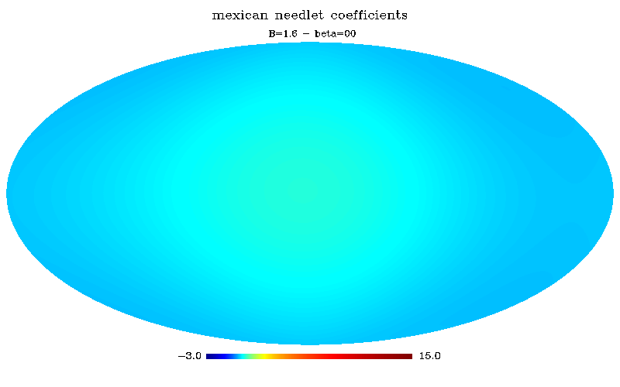
Beta coefficients of the Fermi sky-map
Diffuse signals lay at lower scales → very good estimation if the stronger sources are masked (very standard technique in CMB data analysis).
Only point sources are visible at high needlet orders (diffuse back/foreground simply lives on other angular scales)

Slide 22
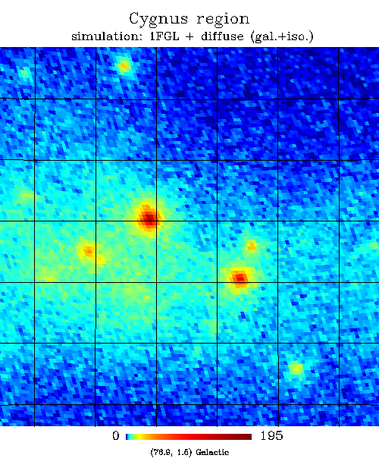
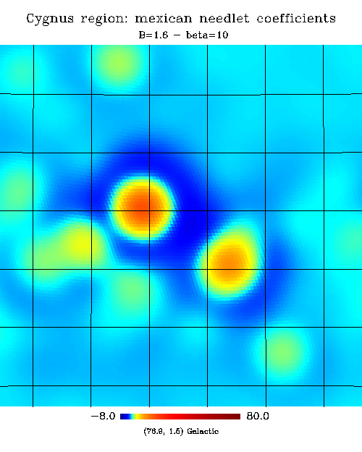
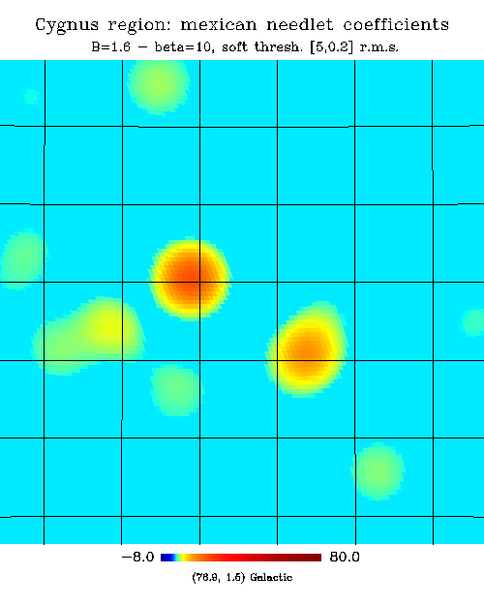
A zoom of the Cygnus region
r.m.s. estimation region
Soft thresholding: we use only beta coefficients larger than 5 r.m.s. (r.m.s. roughly estimated).

Slide 23
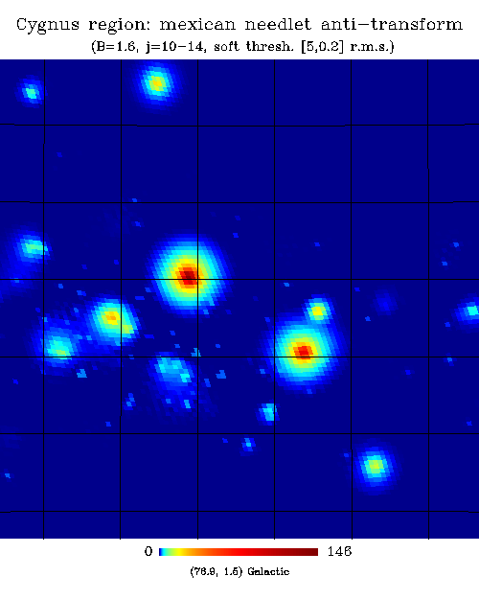
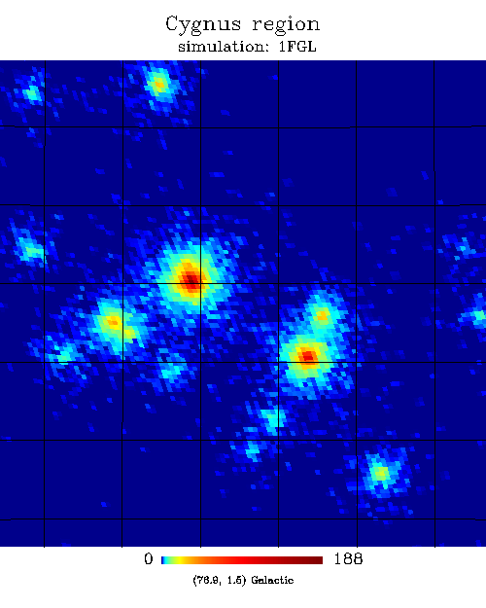
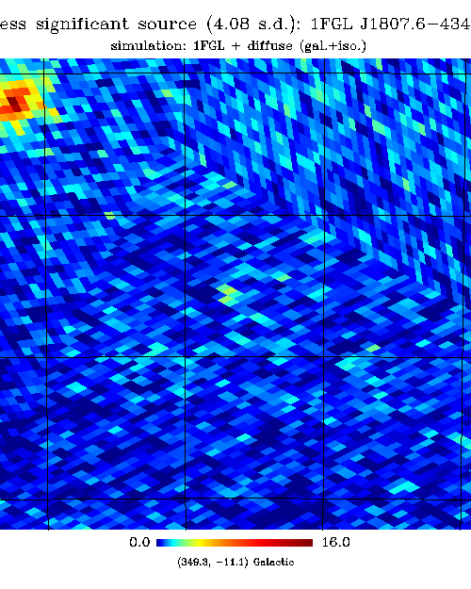
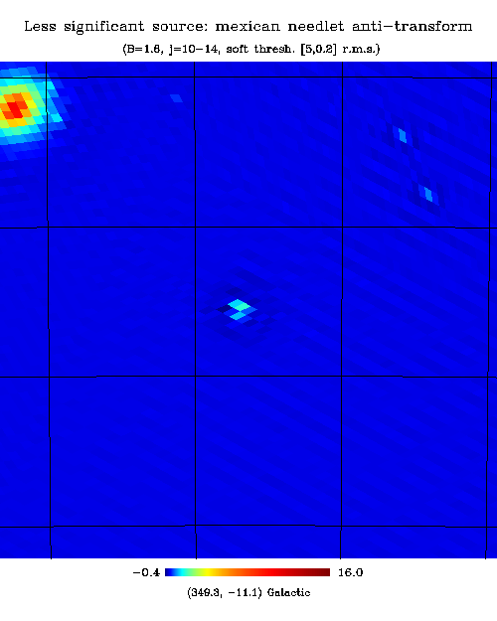
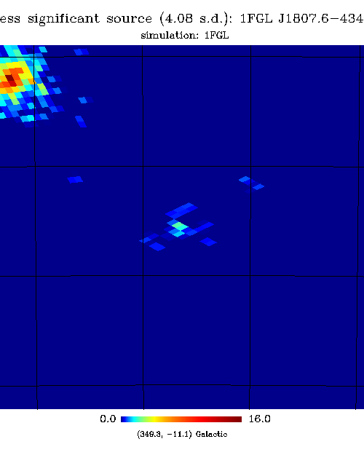
Soft thresholding application
Fermi 1FGL less significant source
r.m.s. estimation region

Slide 24
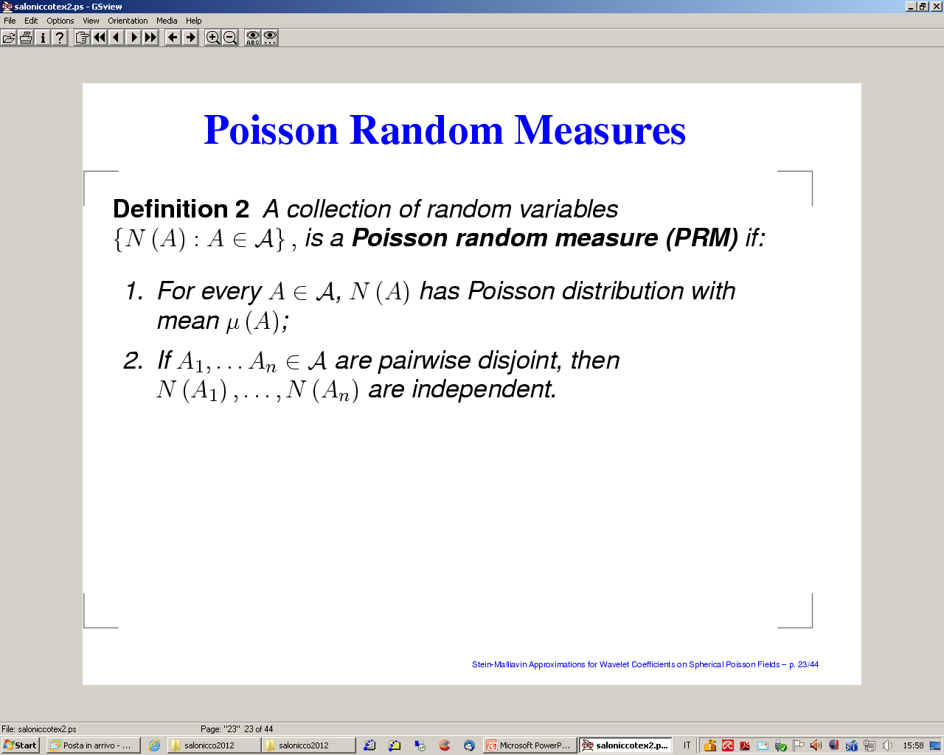

Slide 25
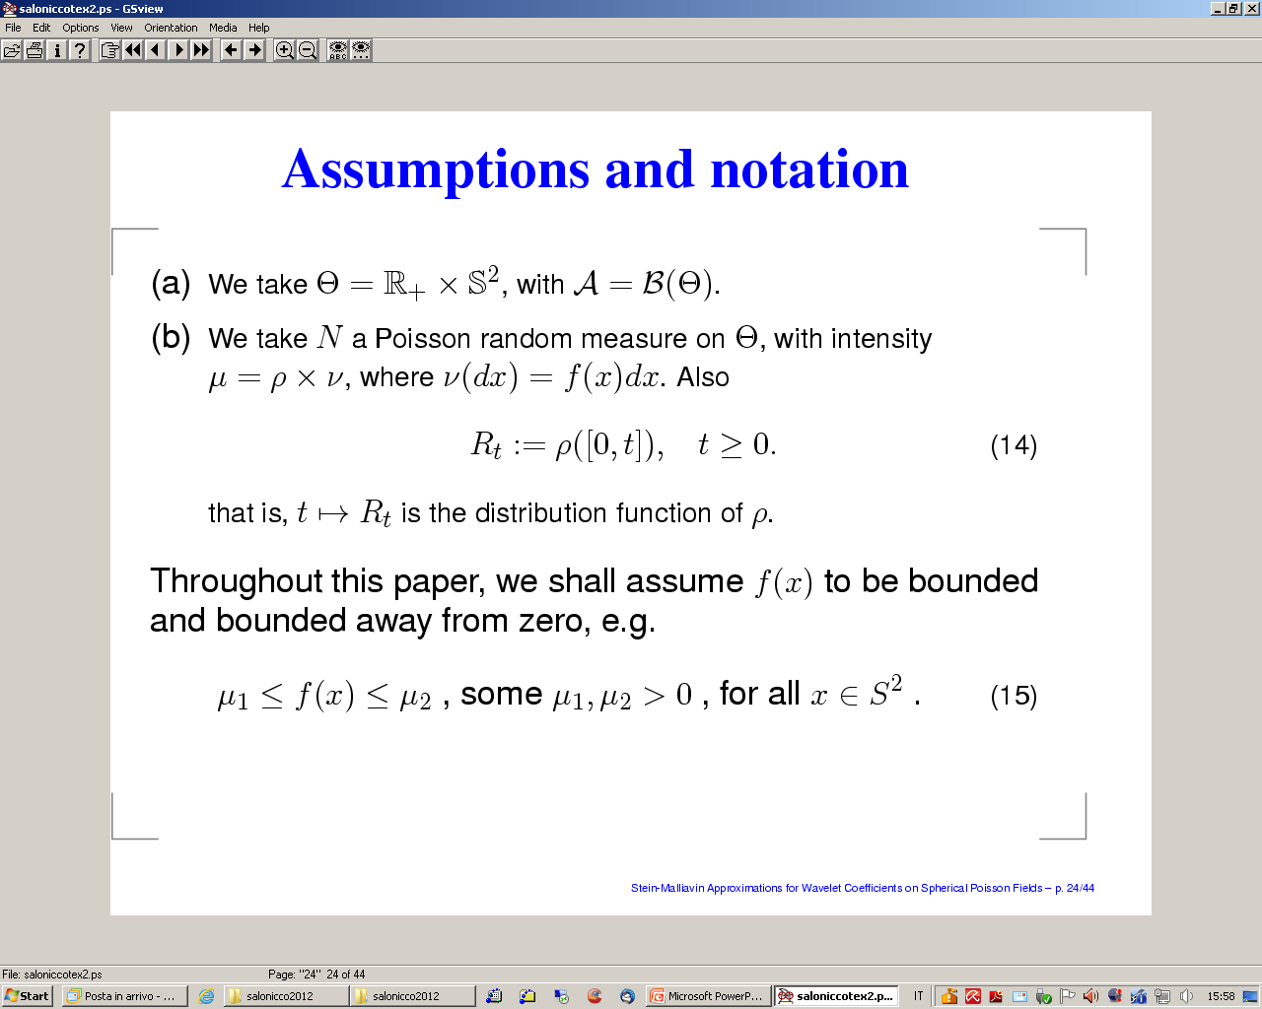

Slide 26
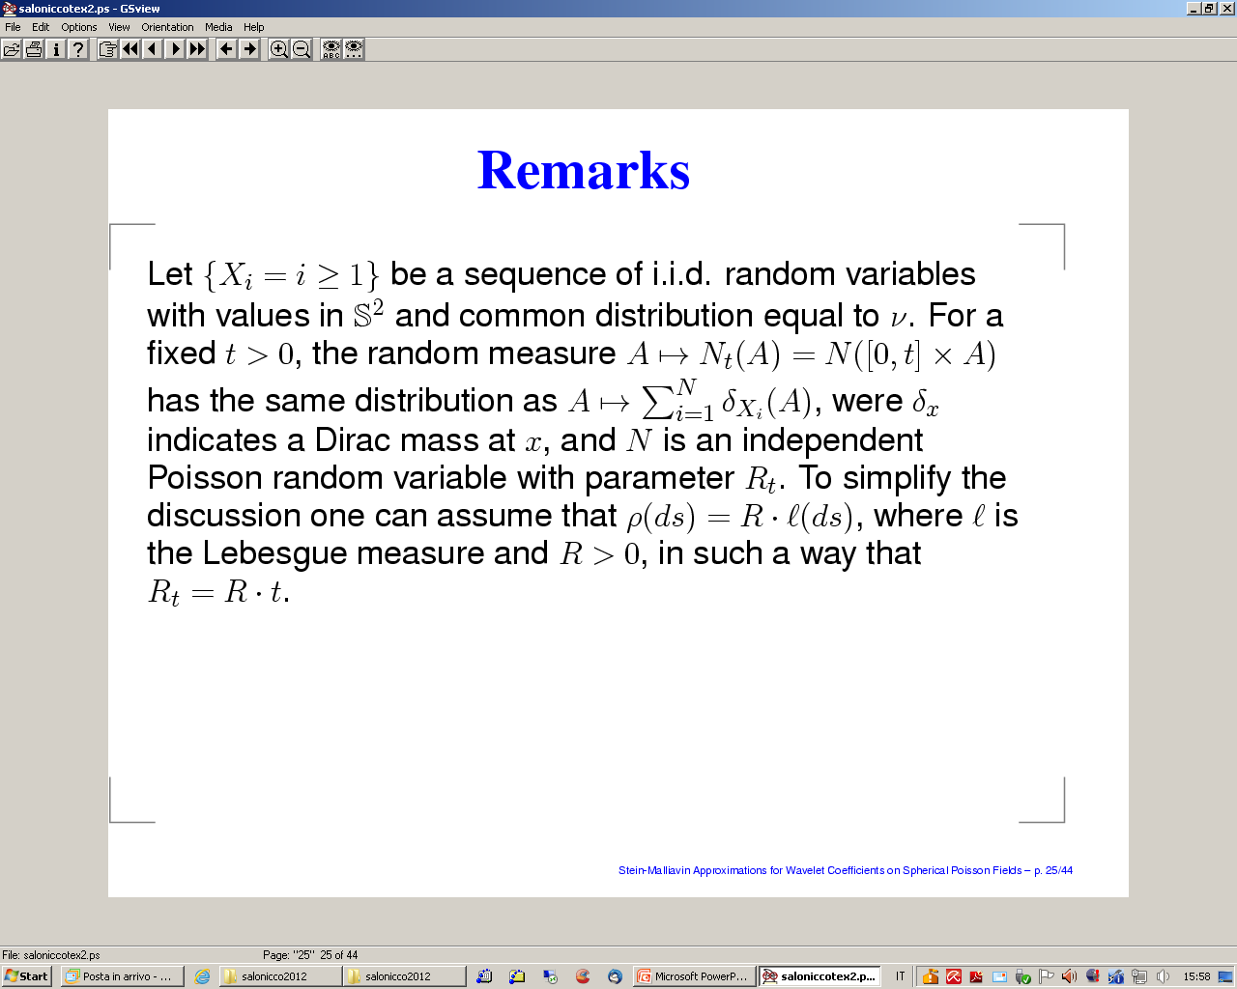

Slide 27
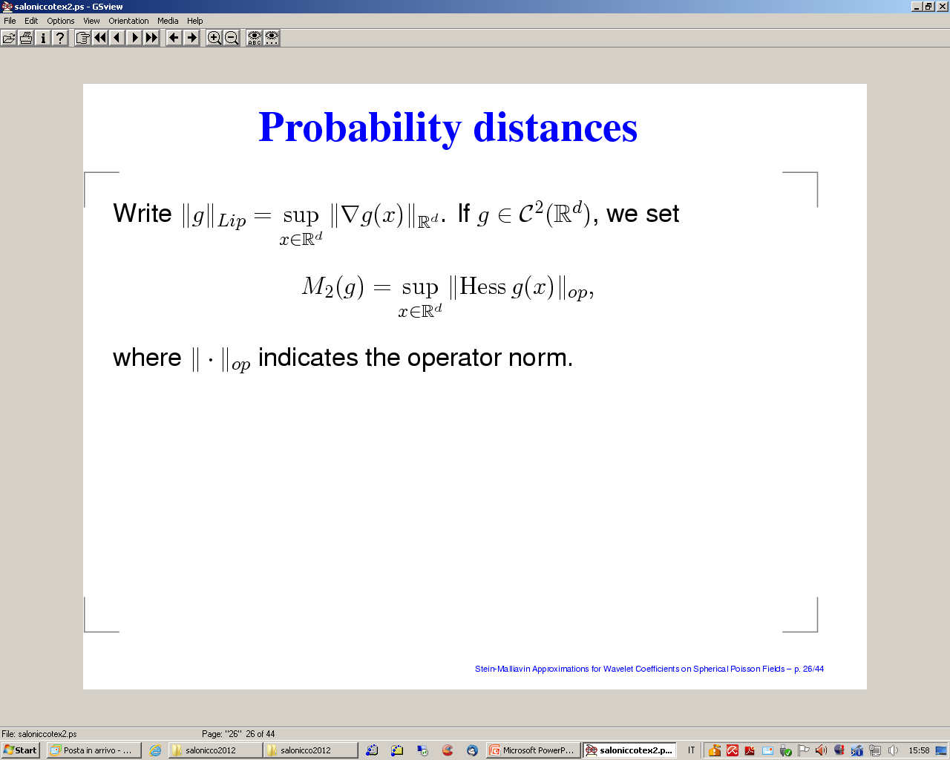

Slide 28
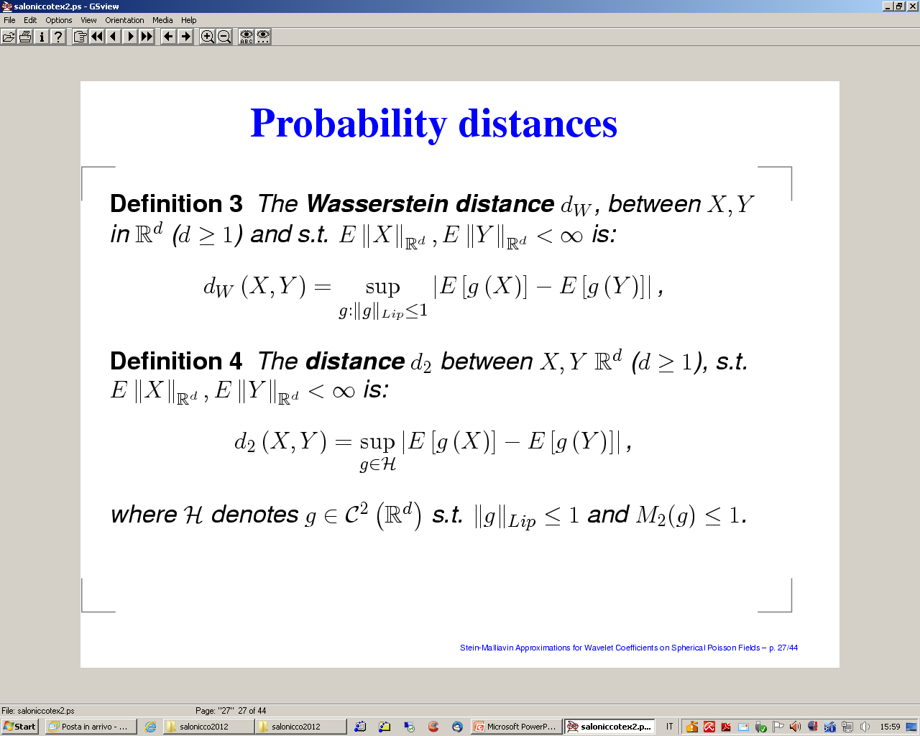

Slide 29
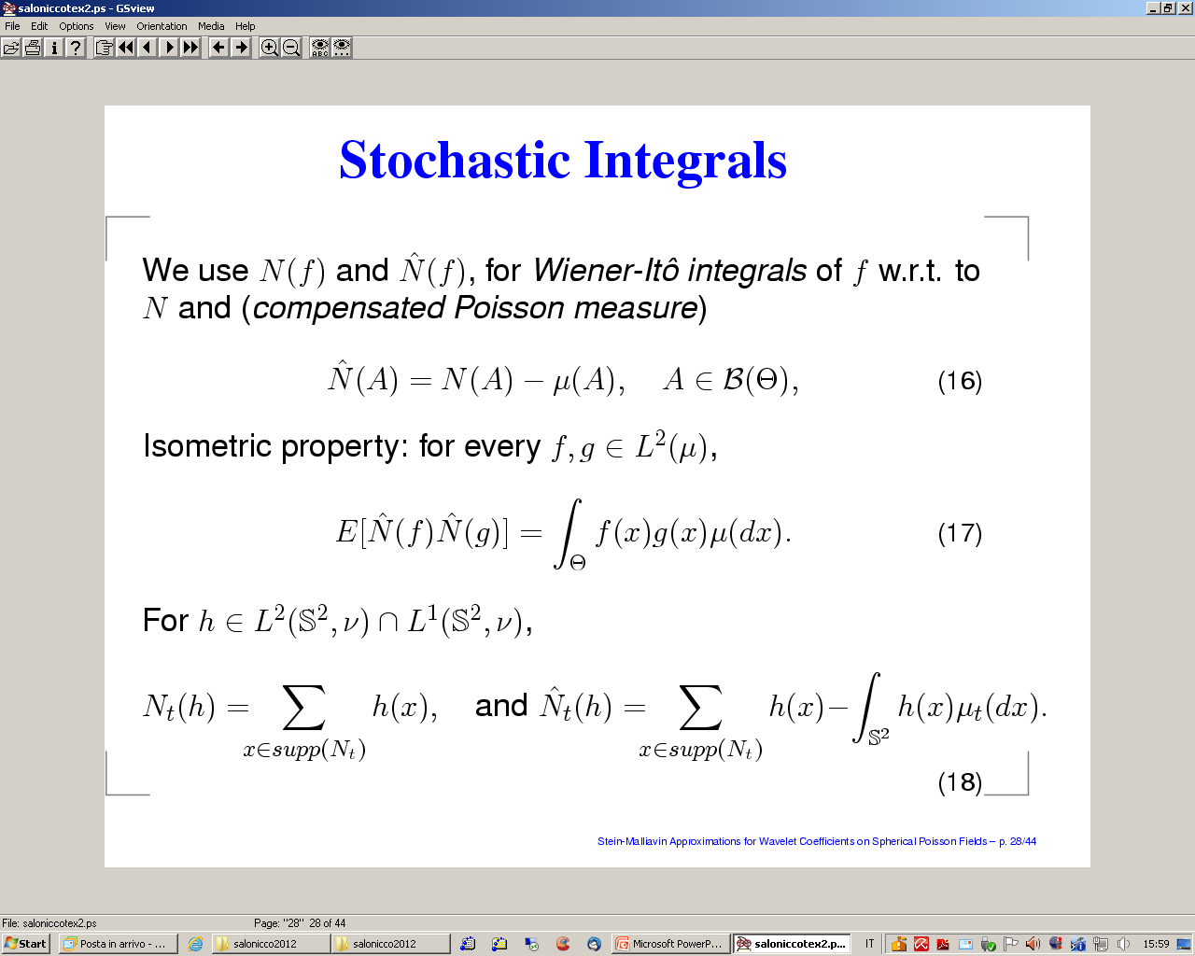

Slide 30
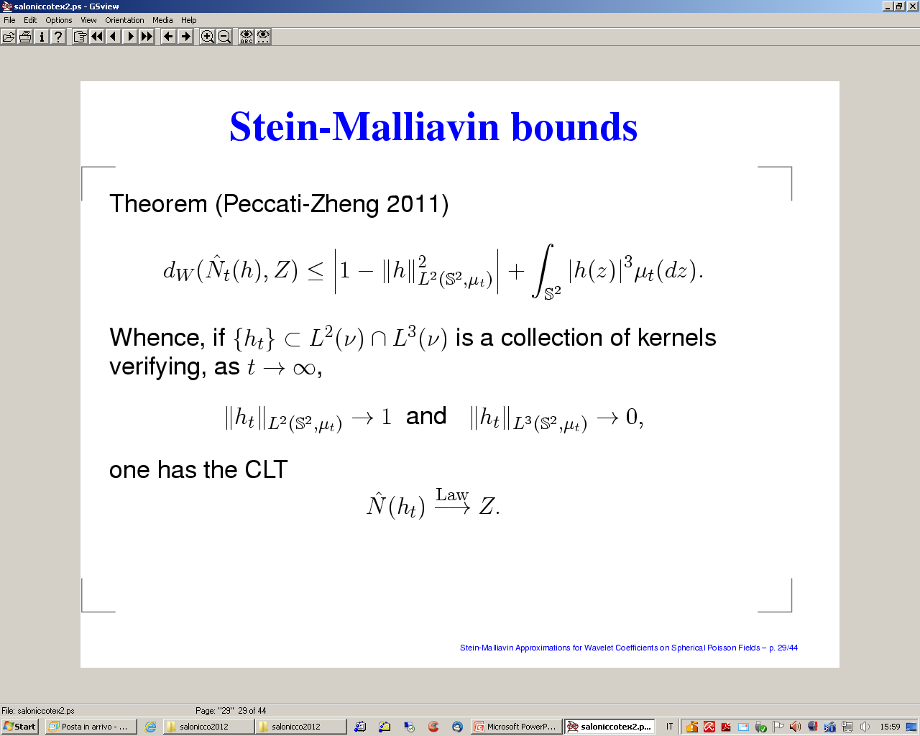

Slide 31
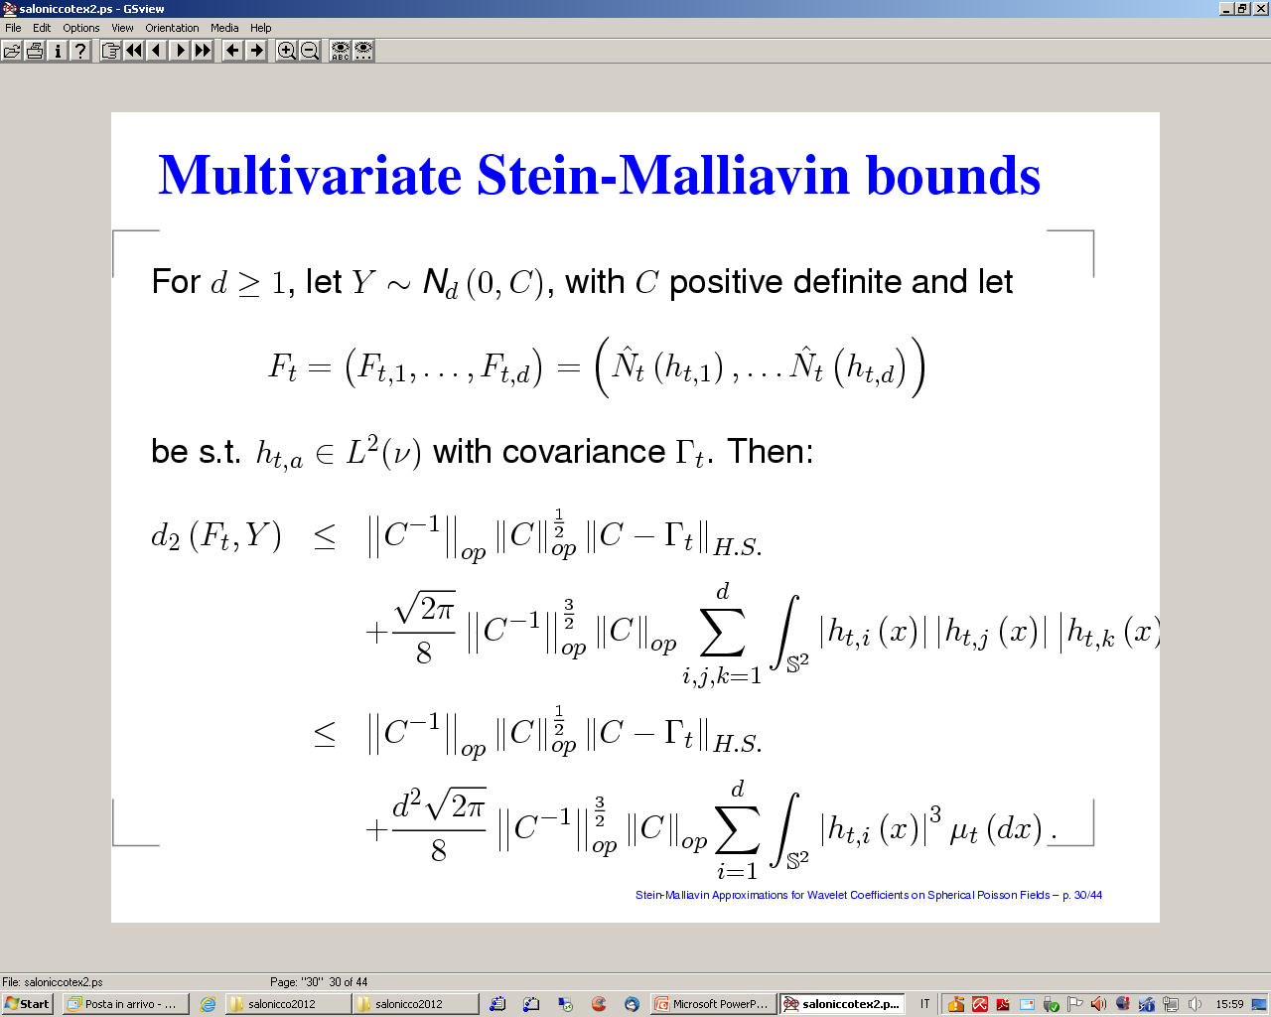

Slide 32
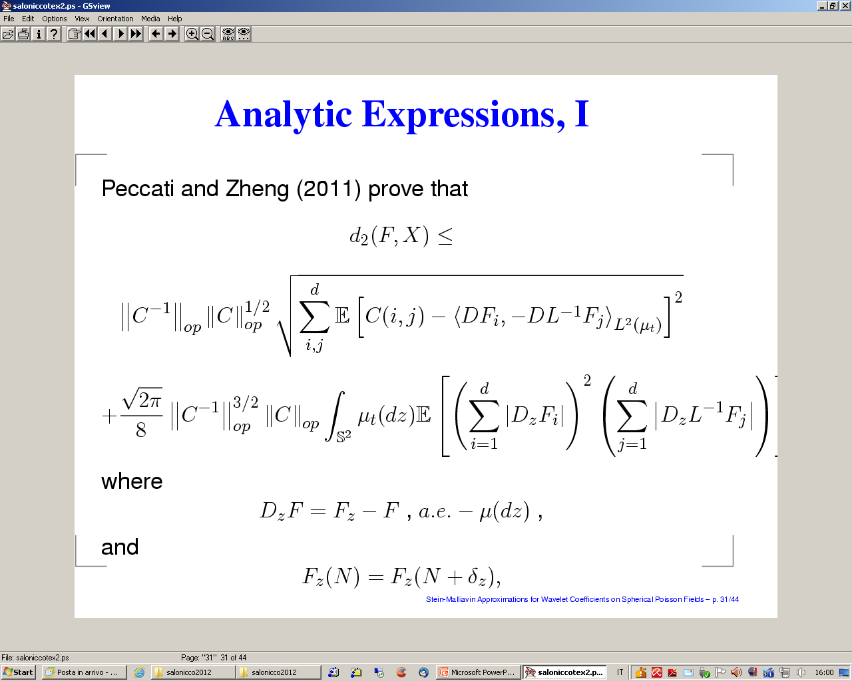

Slide 33


Slide 35


Slide 36


Slide 37


Slide 38


Slide 39


Slide 40


Slide 41


Slide 42


Slide 43


Slide 44


Slide 45


Slide 46


Slide 47


Slide 48




Slide 49




Slide 50




Slide 51




