Slide 1
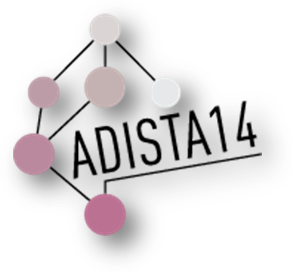
FAMILIES OF
UNIMODAL DISTRIBUTIONS
ON THE CIRCLE
Chris Jones
THE OPEN UNIVERSITY

Slide 2



Slide 3



Slide 4










Slide 5
Structure of Talk
Structure of Talks
a quick look at three families of distributions on the real line R, and their interconnections;
extensions/adaptations of these to families of unimodal distributions on the circle C:
  somewhat unsuccessfully
  then successfully through direct and inverse Batschelet distributions
  then most successfully through our latest proposal
FOR EMPIRICAL USE ONLY
[also Toshi in Talk 3?]
… which Shogo will tell you about in Talk 2

Slide 6
To start with, then, I will concentrate on univariate continuous distributions on (the whole of) R
Part 1)
Here are some ingredients from which to cook them up:
a symmetric unimodal distribution on R with density g
location and scale parameters which will be hidden
one or more shape parameters, accounting for skewness and perhaps tail weight, on which I shall implicitly focus, via certain functions, w ≥ 0 and W, depending on them

Slide 7
FAMILY 1
Azzalini-Type
Skew-Symmetric
FAMILY 2
Transformation of
Random Variable
FAMILY 3
Transformation of
Scale
FAMILY 4
Probability Integral
Transformation of
Random Variable
on [0,1]
SUBFAMILY OF
FAMILY 3
Two-Piece Scale

Slide 8
FAMILY 1
Azzalini-Type Skew Symmetric
Define the density of X_{A} to be
where
w(x) + w(-x) = 1
(Wang, Boyer & Genton, 2004, Statist. Sinica)
The most familiar special cases take w(x) = F(νx) to be the cdf of a (scaled) symmetric distribution
(Azzalini, 1985, Scand. J. Statist., Azzalini with Capitanio, 2014, book)

Slide 9
FAMILY 2
Transformation of Random Variable
Let W: R → R be an invertible increasing function. If Z ~ g, define X_{R} = W(Z). The density of the distribution of X_{R} is, of course,
FOR EXAMPLE
W(Z) = sinh( a + b sinh⁻¹Z )
(Jones & Pewsey, 2009, Biometrika)
where w = W'

Slide 10
FAMILY 3
Transformation of Scale
The density of the distribution of X_{S} is just
… which is a density if
W(x) - W(-x) = x
… corresponding to
w = W’ satisfying
This works because
w(x) + w(-x) = 1
X_{S} = W(X_{A})
(Jones, 2014, Statist. Sinica)

Slide 11
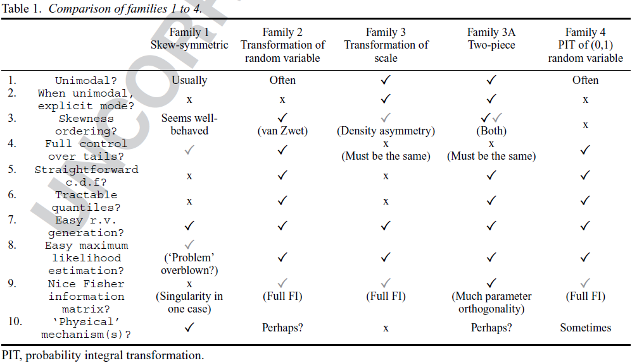
From a review and comparison of families on R in
Jones, forthcoming, Internat. Statist. Rev.:
x₀=W(0)

Slide 12
So now let’s try to adapt these ideas to obtaining distributions on the circle C
Part 2)
The ingredients are much the same as they were on R :
a symmetric unimodal distribution on C with density g
location and concentration parameters which will often be hidden
one or more shape parameters, accounting for skewness and perhaps “symmetric shape”, via certain specific functions, w and W, depending on them

Slide 13
ASIDE: if you like your “symmetric shape”
incorporated into g, then you might use
the specific symmetric family with densities
g_{ψ}(θ) ∝ { 1 + tanh(κψ) cos(θ-μ) }^{1/ψ}
(Jones & Pewsey, 2005, J. Amer. Statist. Assoc.)
EXAMPLES:
Ψ = -1: wrapped Cauchy
Ψ = 0: von Mises
Ψ = 1: cardioid

Slide 14
The main example of skew-symmetric-type distributions on C in the literature takes w(θ) = ½(1 + ν sinθ), -1 ≤ ν ≤ 1:
Part 2a)
f_{A}(θ) = (1 + ν sinθ) g(θ)
(Umbach & Jammalamadaka, 2009, Statist. Probab. Lett.;
Abe & Pewsey, 2011, Statist. Pap.)
This w is nonnegative and satisfies
w(θ) + w(-θ) = 1

Slide 15
Unfortunately, these attractively simple skewed distributions are not always unimodal;
And they can have problems introducing much in the way of skewness, plotted below as a function of ν and a parameter indexing a wide family of choices of g:
Ψ, parameter indexing symmetric family

Slide 16
A nice example of transformation distributions on C uses a Möbius transformation
M⁻¹(θ) = ν + 2 tan⁻¹[ ω tan(½(θ- ν)) ]
What about transformation of random
variables on C ?
f_{R}(θ) = M′(θ) g(M(θ))
(Kato & Jones, 2010, J. Amer. Statist. Assoc.)
This has a number of nice properties, especially with regard to circular-circular regression,
but f_{R} isn’t always unimodal

Slide 17
That leaves “transformation of scale” …
Part 2b)
f_{S}(θ) ∝ g(T(θ))
... which is unimodal provided g is!
(and its mode is at T⁻¹(0) )
A first skewing example is the “direct Batschelet distribution” essentially using the transformation
B(θ) = θ - ν - ν cosθ, -1 ≤ ν ≤ 1.
(Batschelet’s 1981 book;
Abe, Pewsey & Shimizu, 2013, Ann. Inst. Statist. Math.)

Slide 18
-1
-0.8
-0.6
…
ν: 0
…
0.6
0.8
1
B(θ)

Slide 19
Even better is the “inverse Batschelet distribution” which simply uses the inverse transformation B⁻¹(θ) where, as in the direct case, B(θ) = θ - ν - ν cosθ.
(Jones & Pewsey, 2012, Biometrics)

Slide 20
Even better is the “inverse Batschelet distribution” which simply uses the inverse transformation B⁻¹(θ) where, as in the direct case, B(θ) = θ - ν - ν cosθ.
(Jones & Pewsey, 2012, Biometrics)
-1
-0.8
-0.6
…
ν: 0
…
0.6
0.8
1
1
0.8
0.6
…
ν: 0
…
-0.6
-0.8
-1
B(θ)
B⁻¹(θ)

Slide 21
This has density
f_{IB}(θ) = g(B⁻¹(θ))
This is unimodal (if g is) with mode at B(θ) = -2ν
The equality arises because B′(θ) = 1 + ν sinθ equals 2w(θ), the w used in the skew- symmetric example described earlier; just as on R,
if Θ ∼ f_{S}, then Φ = B⁻¹(Θ) ∼ f_{A}.

Slide 22
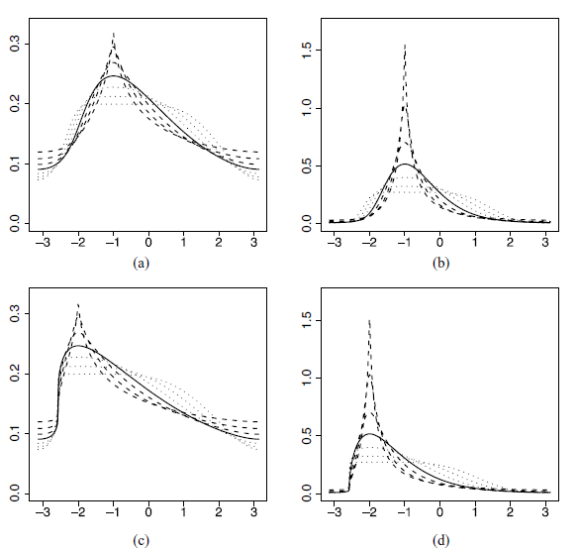
κ=½
κ=2
ν=½
ν=1

Slide 23
Some advantages of inverse Batschelet distributions
f_{IB} is unimodal (if g is)
  with mode explicitly at -2ν *
includes g as special case
has simple explicit density function
  trivial normalising constant, independent of ν **
f_{IB}(θ;-ν) = f_{IB}(-θ;ν) with ν acting as a skewness parameter in a density asymmetry sense
a very wide range of skewness and symmetric shape *
a high degree of parameter orthogonality **
nice random variate generation *
* means not quite so nicely shared by direct Batschelet distributions
** means not (at all) shared by direct Batschelet distributions

Slide 24
Some disadvantages of inverse Batschelet distributions
no explicit distribution function
no explicit characteristic function/trigonometric moments
  method of (trig) moments not readily available
ML estimation slowed up by inversion of B(θ) *
* means not shared by direct Batschelet distributions

Slide 25

Part 2c)
Over to you,
Shogo!

Slide 28

Comparisons: inverse Batschelet vs new model
 | inverse Batschelet | new model
unimodal? | ✓ | ✓
with explicit mode? | ✓ | ✓
includes simple g as special case? | ✓ (von Mises, WC, cardioid) | ✓(WC, cardioid)
simple explicit density function? | ✓ | ✓
f(θ;-ν) = f(-θ;ν)? | ✓ | ✓
understandable skewness parameter? | ✓ | ✓
very wide range of skewness and kurtosis? | ✓ | ✓
high degree of parameter orthogonality? | ✓ | ✗
nice random variate generation? | ✓ | ✓

Slide 29

Comparisons continued
 | inverse Batschelet | new model
explicit distribution function? | ✗ | ✓
explicit characteristic function? | ✗ | ✓
fully interpretable parameters? | ✓ | ✓✓
MoM estimation available? | ✗ | ✓
ML estimation straightforward? | ✓ | ✓
closure under convolution? | ✗ | ✓
FINAL SCORE: inverse Batschelet 10, new model 14

